Slide 1
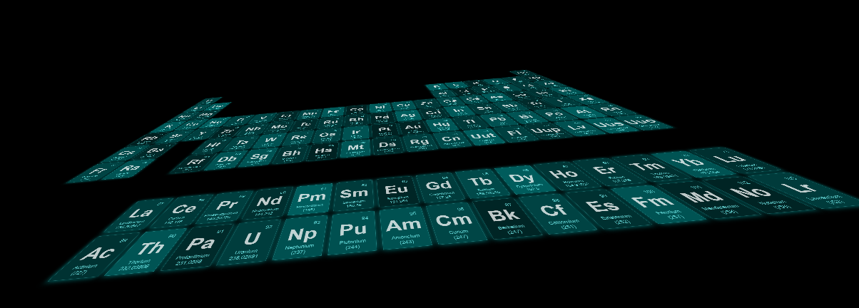
Chemistry, Part 3:
The Periodic Table
Science With Mrs. Notani

Slide 2
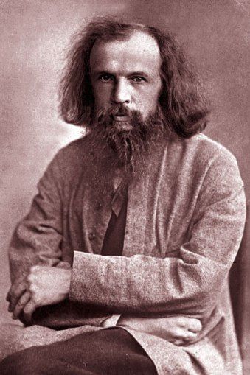
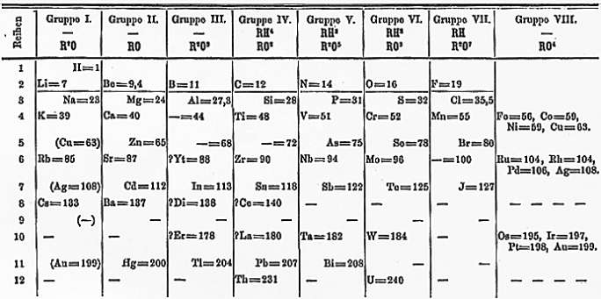
Patterns in the Elements
Dmitri Mendeleev
(1834-1907)
Russian chemist
Old Way = By Atomic Mass
Modern Way = By Atomic Number

Slide 3
Patterns in the Elements
Today:
Properties of elements may be predicted by their placement on the periodic table.
Arranged by atomic number
18 columns called groups/families have similar characteristics
7 rows called periods

Slide 4
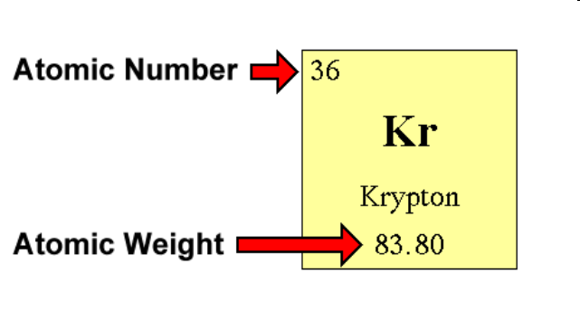
Finding Data on Elements

Slide 5
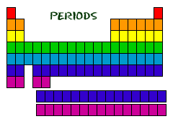
Organization of the Periodic Table

Slide 6
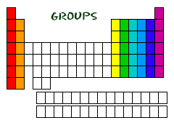
Organization of the Periodic Table

Slide 7
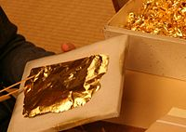
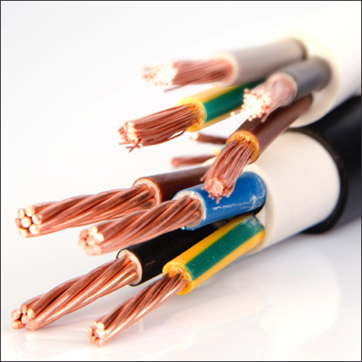
Properties of Metals
Malleability—ability to be hammered or rolled (like coins, swords, and aluminum foil)
Ductility—ability to be pulled out into a thin wire
Physical Properties

Slide 8
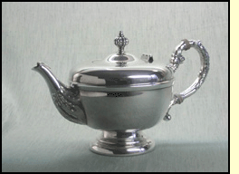
Properties of Metals
Conductivity—ability to transfer heat or electricity
Luster- shininess
Physical Properties

Slide 9
Properties of Metals
Reactivity – ease and speed of combining with other elements
Corrosion – destruction of a metal through reacting with oxygen
Chemical Properties

Slide 10
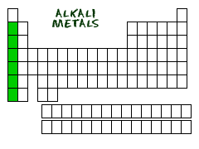
Metals in the Periodic Table
Alkali metals—Group 1, the alkali metals are all highly reactive and are never found in elemental forms in nature, one electron in their outmost electron shells
Alkali metals—Group 1, the alkali metals are all highly reactive and are never found in elemental forms in nature, one electron in their outmost electron shells

Slide 11
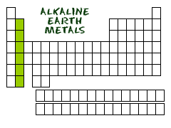
Metals in the Periodic Table
Alkaline earth metals—Group 2, insoluble in water and resistant to heating, two electrons in their valence shell

Slide 12
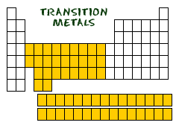
Metals in the Periodic Table
Transition metals—Groups 3-12, characteristics include hard and shiny, good conductors

Slide 13
Metals in the Periodic Table
Earth metals/Metals in Mixed Groups—Group 13-15 below the steps, not very reactive.

Slide 14
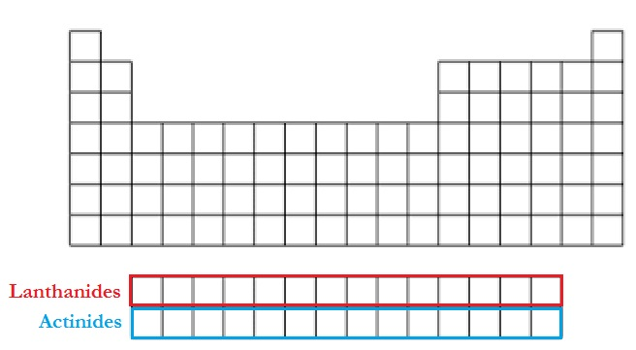
Metals in the Periodic Table
Lanthanides—Top row, soft, malleable, shiny metals with high conductivity, used for alloy (mixture of metals)
Actinides—Bottom row, very unstable

Slide 15
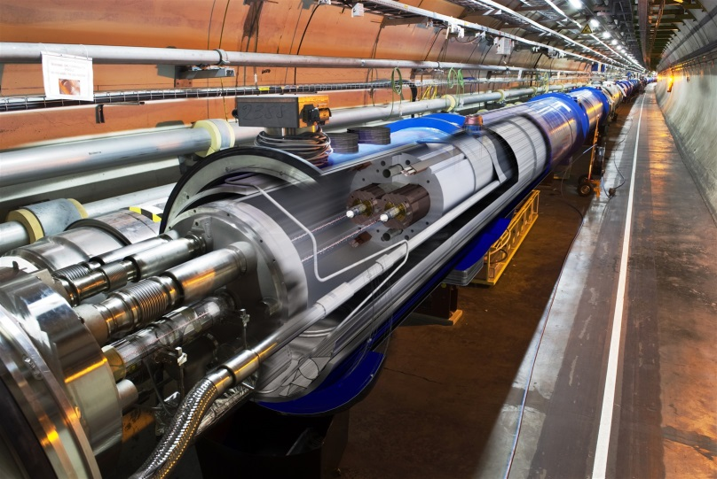
Synthetic Metals
“Synthetic” simply means “man-made.”
Synthetic Elements—any elements with an atomic number higher than 92.
Scientists use particle accelerators to produce them.

Slide 16
Properties of Nonmetals
Mostly Gases – 10 out of 16 nonmetals are gases.
Poor Conductors – (Insulators) – Not good at conducting heat and electricity.
Dull – Not shiny.
Brittle – Easily broken
Physical Properties

Slide 17
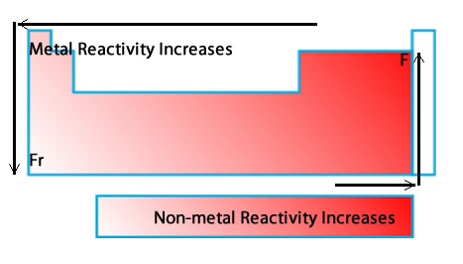
Properties of Nonmetals
Reactive – Most nonmetals form compounds with other elements.
Chemical Properties

Slide 18
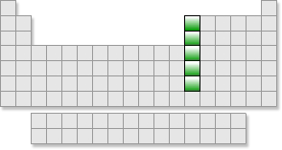
Families of Nonmetals
Boron Family -- Group 13. This group includes the elements Boron, Aluminum, Gallium, Indium, and Thallium. All five have three electrons in their outer energy level.

Slide 19
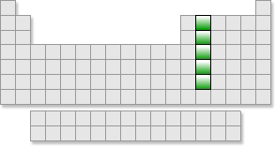
Families of Nonmetals
Carbon Family—Group 14, can gain, lose, or share electrons. 4 electrons in outer shell.

Slide 20
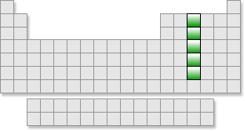
Families of Nonmetals
Nitrogen group—Group 15, can gain or share three electrons, noted for their stability in compounds, this is the property of these elements which leads to their potential toxicity.

Slide 21
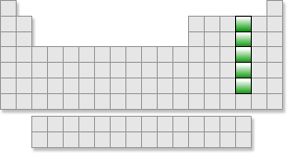
Families of Nonmetals
Oxygen Family —Group 16, can gain or share two electrons

Slide 22
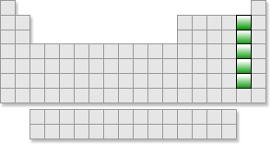
Families of Nonmetals
Halogens—Group 17, can gain or share one electron, very reactive, forms salts

Slide 23
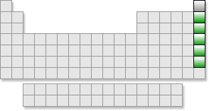
Families of Nonmetals
Noble gases—Group 18, odorless, colorless, with very low chemical reactivity, full valence electron shells

Slide 24
Families of Nonmetals
Hydrogen

Slide 25
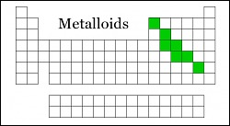
The Metalloids
Metalloids—along the border between metals and nonmetals, have characteristics of both

Slide 27
CHAPTER 10 The Periodic Table mini-Summary

Slide 28
Patterns in the Elements
63 elements discover in 1869, Mendeleev discovered a set of patterns that applied to all the elements
Atomic mass= average mass of all isotopes for that element
He noticed pattern as he arranged the elements by the increasing atomic mass
Mendeleev’s work
Mendeleev's Periodic table
Found properties repeated and he placed them in groups together
Found arrangement by mass did not always group them by similar characteristics
Left blank spaces for undiscovered elements
Published in 1869 first table
Predicting new elements

Slide 29
Modern periodic table
Periodic table- chart of the elements showing the repeating pattern of the chemicals and the properties
Period-a row (periodic means regular repeating pattern)
Rearranged by atomic #
Finding Elements
Square (key) includes the atomic #, symbol, Atomic mass, and name
Atomic Number (#)
Tells you the number of protons

Slide 30
Contains either one upper case letter (K) or one upper case and a lower case (Na) taken from their Latin names
Chemical symbols and names
The last number in key is an average because most elements have isotopes and it is the combined percentage of all of their weights
Average Atomic mass
Organization of the Periodic Table
Arranged by atomic number
Properties of an element may be predicted from its location on the table
Periods
7 horizontal rows (like the days of the week)
Groups
18 Vertical columns, known as families, have similar characteristics

