Slide 1
Classifying and exploring life
Life science chapter 1

Slide 2
Living things are also called organisms
An organism is something that has all of the characteristics of life
  Organization
  Growth and Development
  Reproduction
  Response to Stimuli
  Use Energy
  Adapt and Evolve (not in your book until later, but important to discuss)

Slide 3
Organization
Different structures in organisms have different functions
  Cells=smallest unit of life
    Unicellular organisms=made from a single cell (bacteria)
    Multicellular organisms=made from more than one cell (plants, animals, most fungi)
  Different cells are organized in a way that allows them to do jobs for the organism
    Cardiac cells→cardiac tissue→heart
Cells themselves are organized
  Structures within the cell, called organelles, work together to help the cell function
Atoms→Molecules→Organelles→Cells→Tissues→Organs→
Organ System→Organism

Slide 4
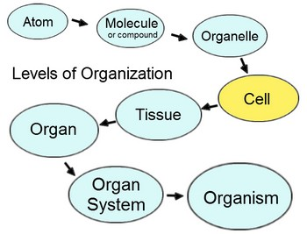
Organization

Slide 5
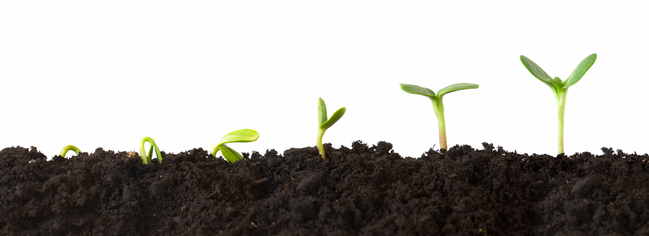
Growth and Development
Growth=getting bigger
  Can be done by adding cells, or by the cells growing
Development=changes that happen during lifetime
  These can happen as growth happens (tadpole to frog) or in between (you now)

Slide 6
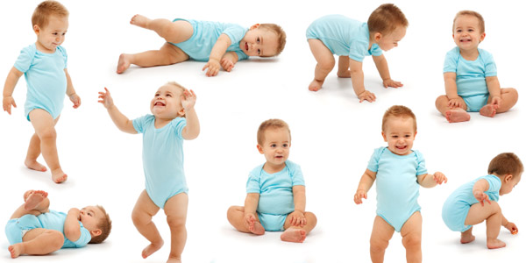

Slide 7
Reproduction
Making babies
  Critical for survival of species
    No babies=extinction
  Not all individuals must reproduce, just enough to keep species going
2 types
  Asexual-one organism splitting into 2
  Sexual-2 organisms mating

Slide 8
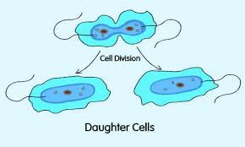
Asexual Reproduction

Slide 9
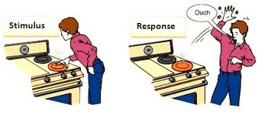
Response to Stimuli
Stimuli-Anything that causes an organism to respond
Response-Any reaction to that stimulus

Slide 10
Types of Stimuli
Internal Stimuli
  A stimulus that comes from within
    Hunger, thirst, etc.
External stimulus
  A stimulus that is caused by the external environment
    Light
    Temperature
    Predators
Minilab

Slide 11
Homeostasis
An organism’s ability to keep internal the same, even when external conditions change.
  Shivering when cold
  Cells can regulate materials
    Take in what they need, get rid of what they don’t want
Inquiry Lab

Slide 12
Energy
All organisms need energy
  Animals, including humans get energy from food
    Where does food get energy?
The ultimate source of energy for all organisms on earth is the sun.
  Hamburger
    The cow had to feed on producers (plants) to get its energy
      Much of that energy was lost to the cow’s bodily functions
        About 10% of it goes to you when you eat the burger

Slide 13
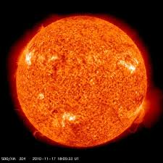
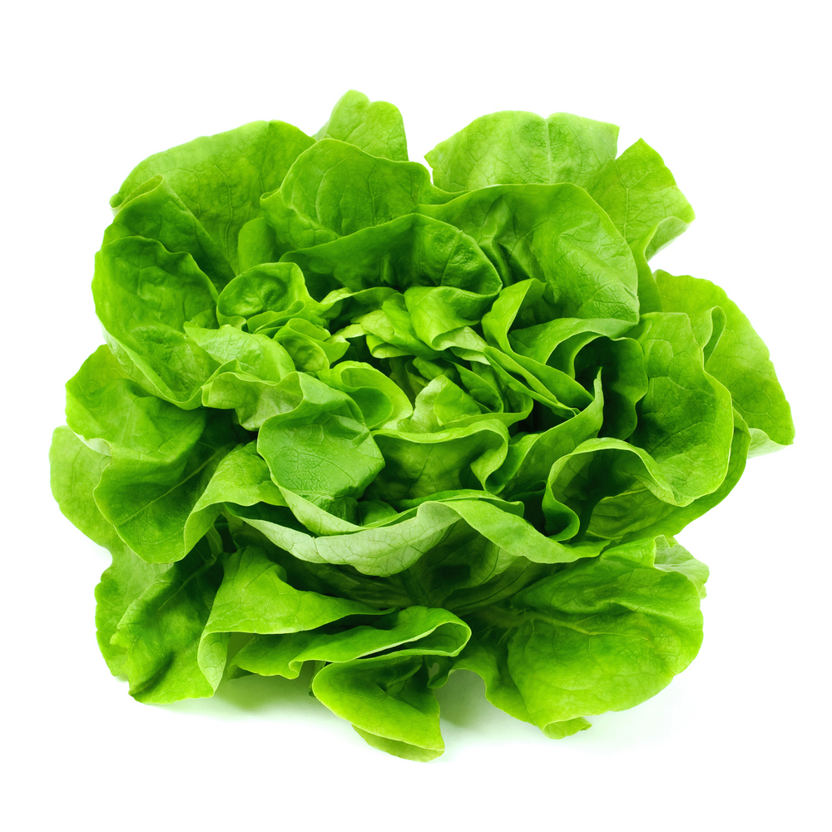
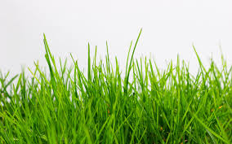
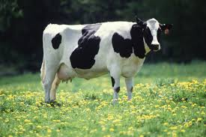
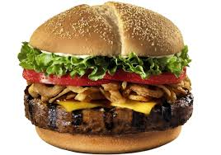
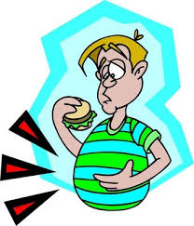

Slide 14
Classification
Classification is the attempt to group similar organisms together
Many people have tried to find a perfect classification scheme
  None were great….
  Some were okay
  Current methods are getting much better

Slide 15
Carolus Linnaeus
2 contributions to life science
  Naming system (to be discussed later)
  First to organize organisms into kingdoms
    Grouped organisms into 2 main groups, called kingdoms
      More evidence and discoveries caused this to be changed

Slide 16
Current Classification System
Modern naming system
  3 Domains
    Bacteria
    Archaea
    Eukarya
  6 Kingdoms
    Bacteria (Domain Bacteria)
    Archaea (Domain Archaea)
    Plantae (Domain Eukarya)
    Animalia (Domain Eukarya)
    Fungi (Domain Eukarya)
    Protista (Domain Eukarya)

Slide 17
Taxonomic Levels
Domain
Kingdom
Phylum
Class
Order
Family
Genus
Species
Did King Phillip Come Over For Great Spaghetti

Slide 18
Scientific Names
Carolus Linnaeus
  2 word naming system
    Called binomial nomenclature
      First word-Genus
      Second word-species
Genus are closely related species
Species are closely related organisms that are able to reproduce and have fertile offspring
  All dogs are the same species

Slide 19
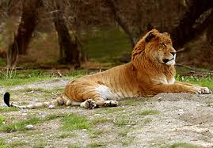
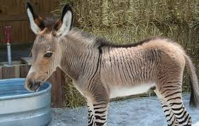
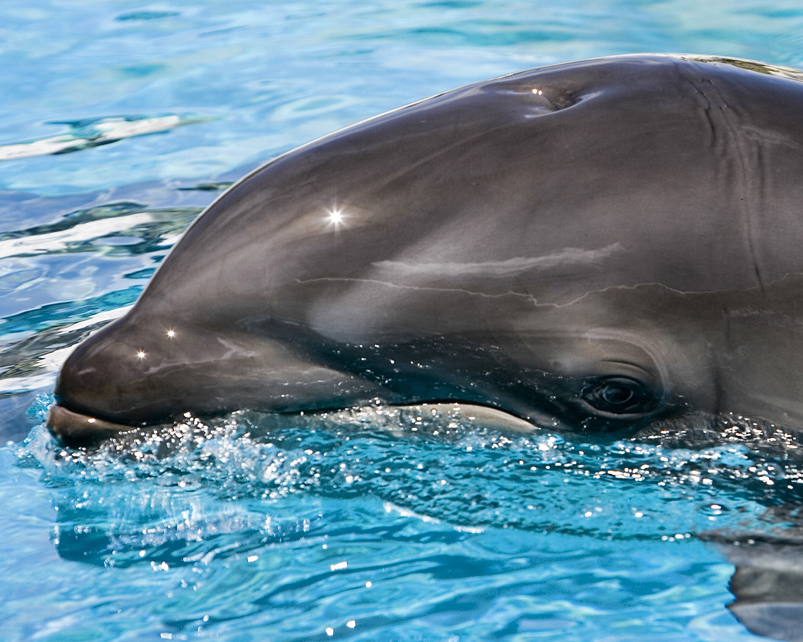
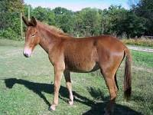

Slide 20
Scientific Name for Humans & Rules
Homo sapien
3 Rules:
  1st word is capitalized
  2nd word is lowercase
  Both words are either italicized (if typed) or underlined (if written)

Slide 21
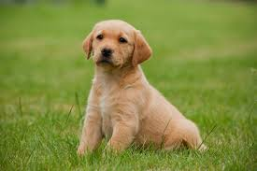
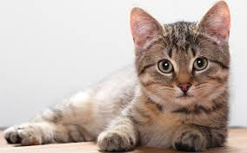
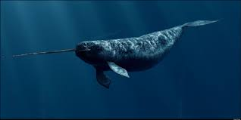
Fix these scientific names:
Canis Familiaris
felis catus
Monodon monoceros

Slide 22
Why Use Scientific Names?
A single name
  Avoids the confusion of multiple common names (Puma, Cougar, Mountain Lion)
Refers to a single type of organism
  More specific (tree vs. Pinus virginiana)
Universal use
  Everyone everywhere uses them

Slide 23
Classification Tools
Dichotomous key
  Pairs of descriptions that lead to identification of an unknown organism
Cladograms
  Branched diagram showing evolutionary history and relationships between organisms

Slide 24
Dichotomous Key

Slide 25
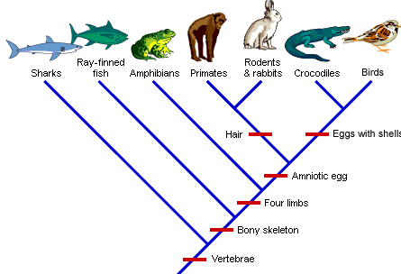
Cladogram

