Slide 1
Chapter Menu
Chapter 2
Cell Structure and Function

Slide 2
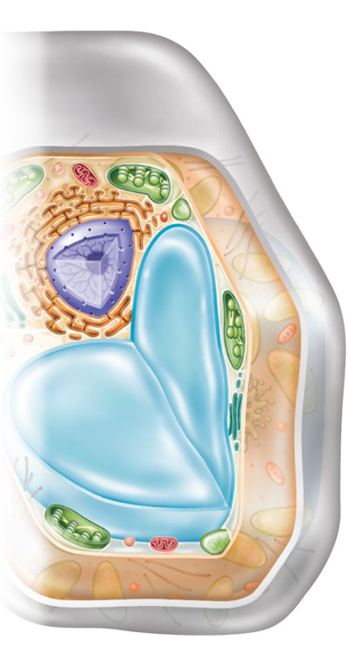
Chapter Menu
Chapter Introduction
Lesson 1 Cells and Life
Lesson 2 The Cell
Lesson 3 Moving Cellular Material
Lesson 4 Cells and Energy
Chapter Wrap-Up

Slide 3
Chapter Introduction
How do the structures and processes of a cell enable it to survive?

Slide 4
Chapter Introduction
What do you think?
Before you begin, decide if you agree or disagree with each of these statements. As you view this presentation, see if you change your mind about any of the statements.

Slide 5
Chapter Introduction
Do you agree or disagree?
1. Nonliving things have cells.
2. Cells are made mostly of water.
3. Different organisms have cells with different structures.
4. All cells store genetic information in their nuclei.

Slide 6
Chapter Introduction
Do you agree or disagree?
5. Diffusion and osmosis are the same process.
6. Cells with large surface areas can transport more than cells with smaller surface areas.
7. ATP is the only form of energy found in cells.
8. Cellular respiration occurs only in lung cells.

Slide 7
Lesson 1 Reading Guide
Cells and Life
How did scientists’ understanding of cells develop?
What basic substances make up a cell?

Slide 8
Lesson 1 Reading Guide
Cells and Life
cell theory
macromolecule
nucleic acid
protein
lipid
carbohydrate

Slide 9
Lesson 1
Understanding Cells
English scientist Robert Hooke first identified cells over 300 years ago while looking at cork under a microscope he built.
After Hooke’s discovery, other scientists began to use better microscopes to identify different structures in the cells of plants and animals.

Slide 10
Lesson 1
Cell theory includes three principles.
Getty Images

Slide 11
Lesson 1
Understanding Cells (cont.)
How did scientists’ understanding of cells develop?

Slide 12
Lesson 1
Basic Cell Substances
The main ingredient in any cell is water. A water molecule has two areas:
The negative (–) end can attract the positive part of another substance.
The positive (+) end can attract the negative part of another substance.

Slide 13
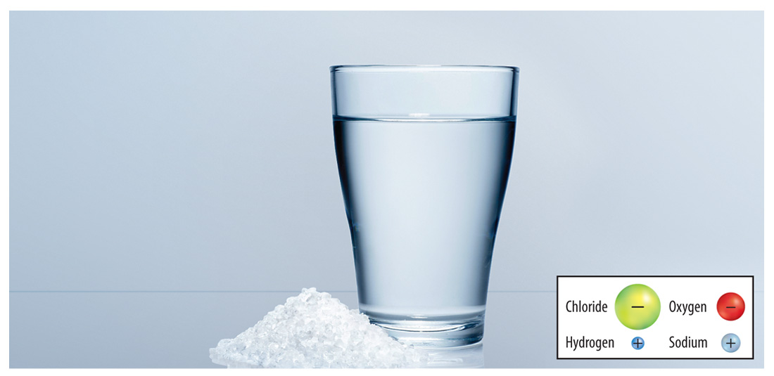
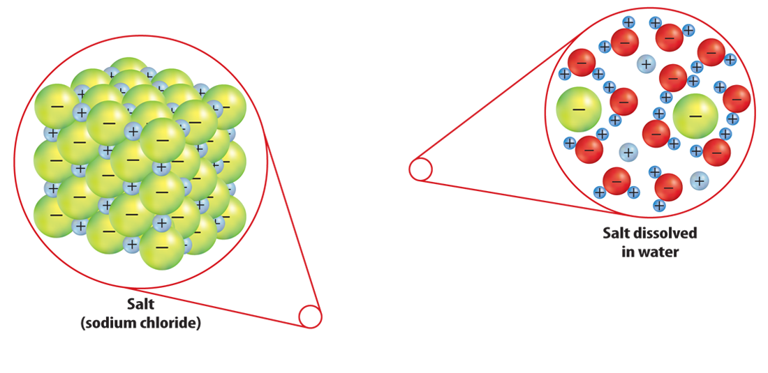
Lesson 1
Basic Cell Substances (cont.)
Water and salt both have positive and negative parts.
FoodCollection/SuperStock

Slide 14
Lesson 1
Basic Cell Substances (cont.)
Macromolecules are necessary substances in cells, formed by joining many small molecules together.
macromolecule
from Greek makro–, means “long”; and Latin molecula, means “mass”

Slide 15
Lesson 1
Basic Cell Substances (cont.)
There are four types of macromolecules in cells:
Nucleic acids are macromolecules that form when long chains of molecules called nucleotides join together.
Proteins are long chains of amino acid molecules.

Slide 16
Lesson 1
Basic Cell Substances (cont.)
Lipids are large macromolecules that do not dissolve in water.
Carbohydrates store energy, provide structural support, and are needed for communication between cells.

Slide 17
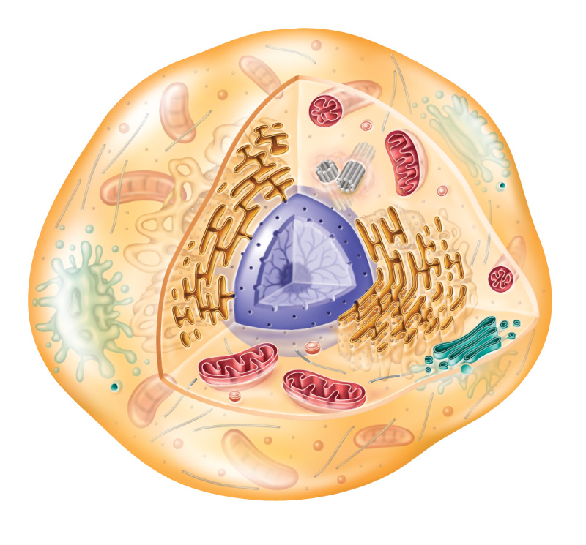
Lesson 1
Each type of macromolecule has unique functions in the cell.

Slide 18
Lesson 1
Basic Cell Substances (cont.)
What basic substances make up a cell?

Slide 19
Lesson 1
The cell theory summarizes the main principles for understanding that the cell is the basic unit of life.
Getty Images

Slide 20
Lesson 1
Water is the main ingredient in every cell.

Slide 21
Lesson 1
A nucleic acid, such as DNA, contains the genetic information for a cell.

Slide 22
Lesson 1
What was Robert Hooke looking at under a microscope when he first identified molecules?
A. pond water
B. skin
C. cork
D. plants

Slide 23
Lesson 1
What is the term for substances formed by joining many molecules together?
A. macromolecules
B. cells
C. proteins
D. lipids

Slide 24
Lesson 1
What are large macromolecules that do not dissolve in water?
A. carbohydrates
B. nucleic acids
C. lipids
D. proteins

Slide 25
Lesson 1
Do you agree or disagree?
1. Nonliving things have cells.
2. Cells are made mostly of water.

Slide 26
Lesson 2 Reading Guide
The Cell
How are prokaryotic cells and eukaryotic cells similar, and how are they different?
What do the structures in a cell do?

Slide 27
Lesson 2 Reading Guide
The Cell
cell membrane
cell wall
cytoplasm
cytoskeleton
organelle
nucleus
chloroplast

Slide 28
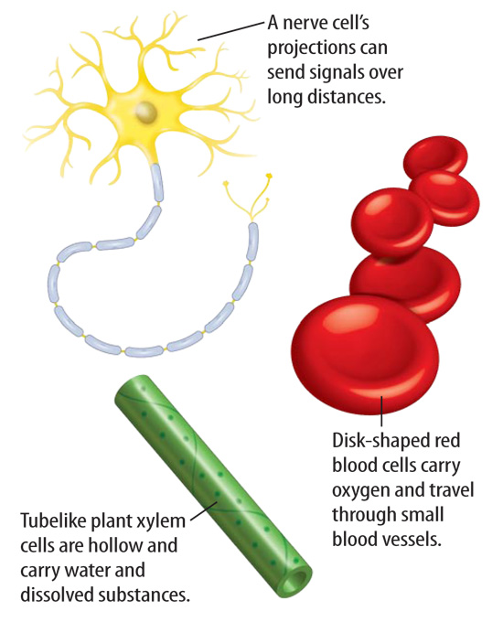
Lesson 2
Cell Shape and Movement
The size and shape of a cell relates to its job or function.
Cells are made of different structures that perform different functions that keep a cell alive.

Slide 29
Lesson 2
Cell Shape and Movement
The cell membrane is a flexible covering that protects the inside of a cell from the environment outside a cell.
A cell wall is a stiff structure outside the cell membrane that protects a cell from attack by viruses and other harmful organisms.

Slide 30
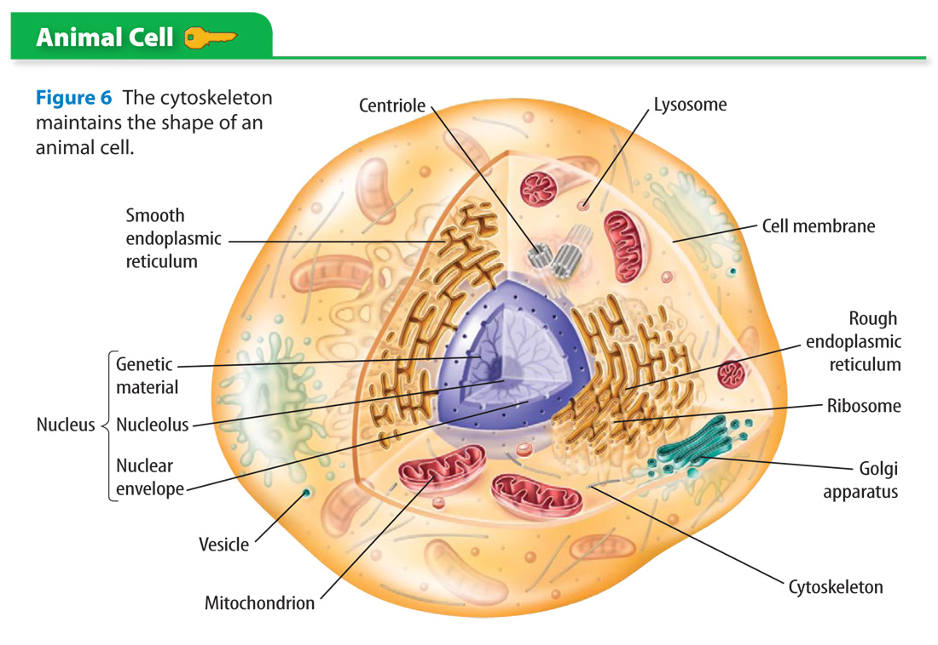
Lesson 2
The cytoskeleton maintains the shape of an animal cell.

Slide 31
Lesson 2
Cell Shape and Movement (cont.)
Cell appendages, like flagella and cilia, are often used for movement.
The cytoskeleton is a network of threadlike proteins that are joined together.

Slide 32
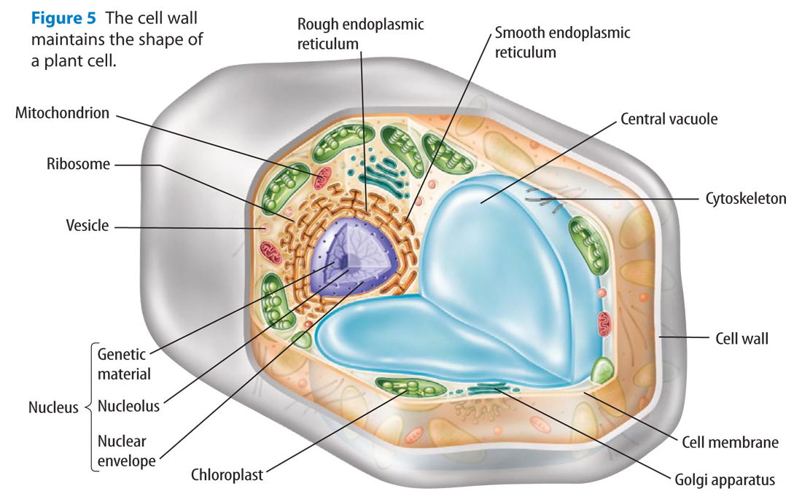
Lesson 2
The cell wall maintains the shape of a plant cell.

Slide 33
Lesson 2
Cell Shape and Movement (cont.)
Cytoplasm is fluid inside a cell that contains most of the cell’s water, salts, other molecules, and the cytoskeleton.
cytoplasm
from Greek kytos, means “hollow vessel”; and plasma, means “something molded”

Slide 34
Lesson 2
Cell Types
With more advanced microscopes, scientists discovered that all cells can be grouped into two types:
prokaryotic cells
eukaryotic cells
Most prokaryotic cells are unicellular organisms called prokaryotes.

Slide 35
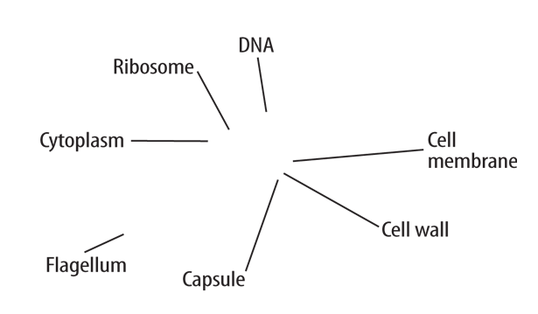
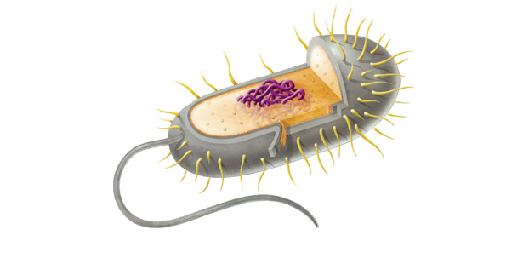
Lesson 2
Cell Types (cont.)
The genetic material in a prokaryotic cell is not surrounded by a membrane.

Slide 36
Lesson 2
Cell Types (cont.)
Plants, animals, fungi, and protists are all made of eukaryotic cells and are called eukaryotes.
In eukaryotic cells, the genetic material is surrounded by a membrane.

Slide 37
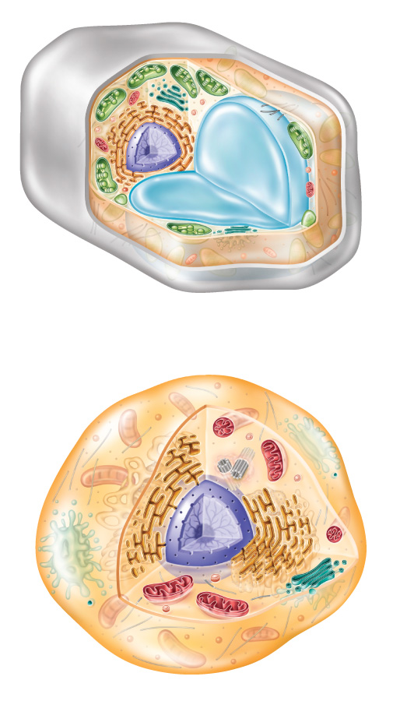
Lesson 2
Every eukaryotic cell has membrane-surrounded organelles, which have specialized functions and enable the cell to carry out different functions at the same time.

Slide 38
Lesson 2
Cell Types (cont.)
How are prokaryotic cells and eukaryotic cells similar, and how are they different?

Slide 39
Lesson 2
Nucleus
Organelles enable cells to carry out different functions at the same time.
The nucleus is the part of a eukaryotic cell that directs cell activities and contains genetic information stored in DNA.

Slide 40
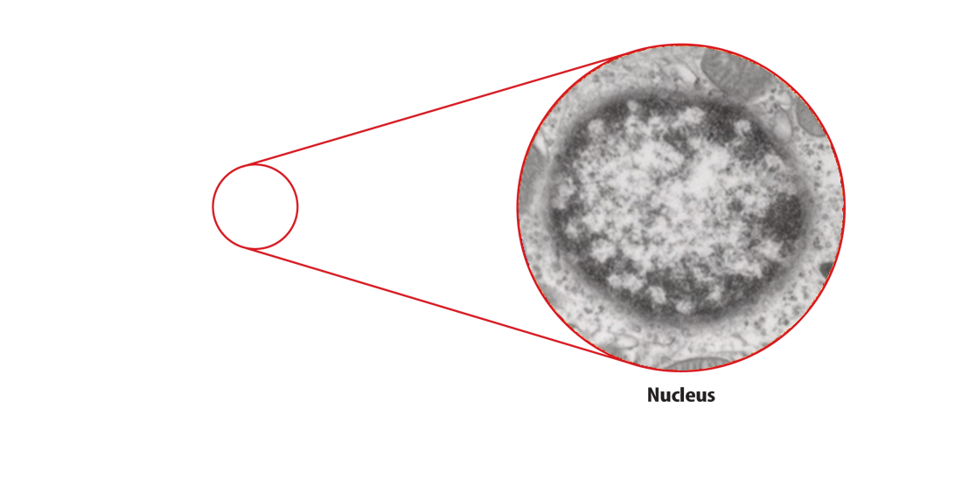
Lesson 2
Nucleus (cont.)
In most cells, the nucleus is the largest organelle.
EM Research Services, Newcastle University

Slide 41
Lesson 2
Nucleus (cont.)
DNA in the nucleus is organized into structures called chromosomes.
The nucleolus is also contained in the nucleus and makes ribosomes, organelles involved in the production of proteins.
The nuclear envelope is a porous, two-membrane structure that surrounds the nucleus.

Slide 42
Lesson 2
Nucleus (cont.)
envelope
Science Use an outer covering
Common Use a flat paper container for a letter

Slide 43
Lesson 2
Manufacturing Molecules
Ribosomes are in a cell’s cytoplasm and make proteins.
Ribosomes can be attached to a weblike organelle called the endoplasmic reticulum, or ER.
ER with ribosomes on its surface is called rough ER and is the site of protein production.

Slide 44
Lesson 2
Manufacturing Molecules (cont.)
ER without ribosomes is called smooth ER. It makes lipids like cholesterol and helps remove harmful substances from a cell.

Slide 45
Lesson 2
Processing Energy
Most eukaryotic cells contain mitochondria, where energy-releasing reactions occur.
Chloroplasts are membrane-bound organelles that use light energy and make food—a sugar called glucose—from water and carbon dioxide through the process of photosynthesis.

Slide 46
Lesson 2
Processing, Storing, and Transporting Molecules
The Golgi apparatus prepares proteins for their specific functions and packages the proteins into vesicles.
Vesicles are organelles that transport substances from one area of a cell to another area of a cell.
Vacuoles—organelles found in some cells—store food, water, and waste material.

Slide 47
Lesson 2
Cell Organelles

Slide 48
Lesson 2
Cell Organelles (cont.)
What is the function of the Golgi apparatus?

Slide 49
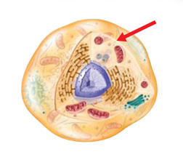
Lesson 2
A cell is protected by a flexible covering called the cell membrane.

Slide 50
Lesson 2
Cells can be grouped into two types— prokaryotic cells and eukaryotic cells.
In a chloroplast, light energy is used for making sugars in a process called photosynthesis.

Slide 51
Lesson 2
What is the flexible covering that protects the inside of a cell from the environment outside a cell?
A. appendages
B. wall
C. membrane
D. organelles

Slide 52
Lesson 2
Plants, animals, fungi, and protists are all made of which of these?
A. eukaryotic cells
B. prokaryotic cells
C. organelles
D. chloroplasts

Slide 53
Lesson 2
What is the name for the part of a eukaryotic cell that directs cell activities and contains genetic information stored in DNA?
A. cell membrane
B. nucleus
C. Golgi apparatus
D. nuclear envelope

Slide 54
Lesson 2
Do you agree or disagree?
3. Different organisms have cells with different structures.
4. All cells store genetic information in their nuclei.

Slide 55
Lesson 3 Reading Guide
Moving Cellular Material
How do materials enter and leave cells?
How does cell size affect the transport of materials?

Slide 56
Lesson 3 Reading Guide
Moving Cellular Material
passive transport
diffusion
osmosis
facilitated diffusion
active transport
endocytosis
exocytosis

Slide 57
Lesson 3
Passive Transport
Passive transport is the movement of substances through a cell membrane without using the cell’s energy.
Small molecules, such as oxygen and carbon dioxide, pass through membranes via passive transport.
Passive transport depends on the amount of substance on each side of a membrane.

Slide 58
Lesson 3
Diffusion
Diffusion is the movement of substances from an area of higher concentration to an area of lower concentration.
diffusion
from Latin diffusionem, means “scatter, pour out”

Slide 59
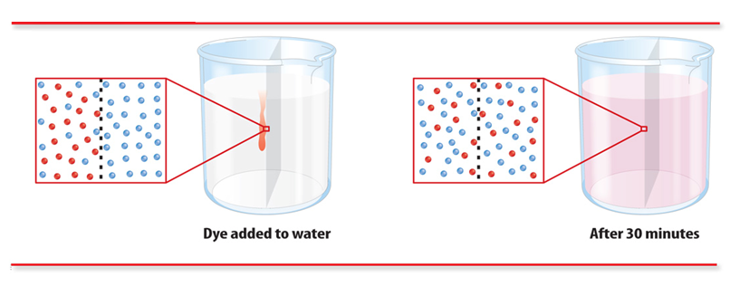
Lesson 3
Diffusion (cont.)
Diffusion continues until the concentration of a substance is the same on both sides of the membrane. The substance is then in equilibrium.

Slide 60
Lesson 3
Osmosis—The Diffusion of Water
Osmosis is the diffusion of water molecules only through a membrane.
Semipermeable cell membranes allow water to pass through them until equilibrium occurs.

Slide 61
Lesson 3
Facilitated Diffusion
Facilitated diffusion occurs when molecules pass through a cell membrane using special proteins called transport proteins.
Carrier proteins are transport proteins that carry large molecules through the cell membrane.
Channel proteins are transport proteins that form pores through the cell membrane.

Slide 62
Lesson 3
Facilitated Diffusion

Slide 63
Lesson 3
Active Transport
Active transport is the movement of substances through a cell membrane only by using the cell’s energy.
Substances moving by active transport can move from areas of lower concentration to areas of higher concentration.
Cells can take in needed nutrients from the environment through carrier proteins by using active transport.

Slide 64
Lesson 3
Active Transport (cont.)
Endocytosis is the process during which a cell takes in a substance by surrounding it with a cell membrane.
Exocytosis is the process during which a cell’s vesicles release their contents outside the cell.

Slide 65
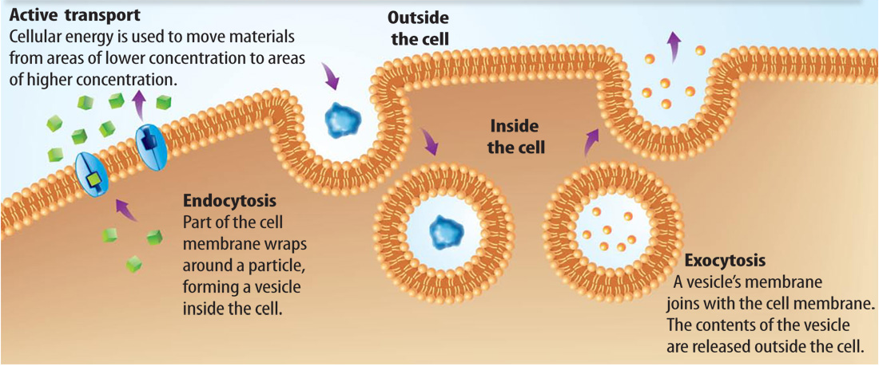
Lesson 3
Active Transport

Slide 66
Lesson 3
Active Transport (cont.)
How do materials enter and leave cells?

Slide 67
Lesson 3
Cell Size and Transport
The area of the cell membrane must be large compared to its volume so that substances can move into and out of the cell.
The area of the cell membrane is the cell’s surface area.
The volume is the amount of space inside the cell.

Slide 68
Lesson 3
Cell Size and Transport (cont.)
How does cell size affect the transport of materials?

Slide 69
Lesson 3
Small molecules can move from an area of higher concentration to an area of lower concentration by diffusion.

Slide 70
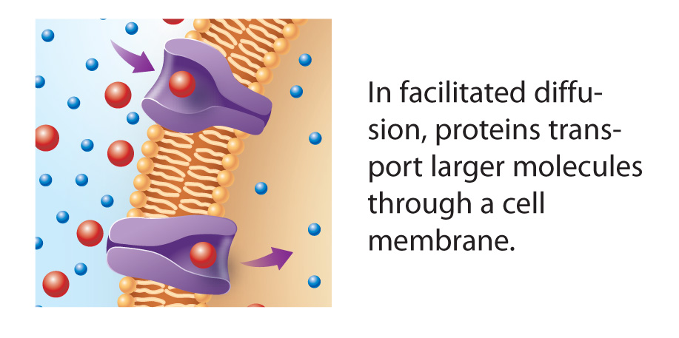
Lesson 3
In facilitated diffusion, proteins transport larger molecules through a cell membrane.

Slide 71
Lesson 3
Some molecules move from areas of lower concentration to areas of higher concentration through active transport.

Slide 72
Lesson 3
Osmosis is the diffusion of water molecules though which of these?
A. channel proteins
B. water
C. cell wall
D. membrane

Slide 73
Lesson 3
How does active transport move substances through the cell membrane?
A. using the cell’s energy
B. by osmosis
C. by facilitated diffusion
D. using water

Slide 74
Lesson 3
Which process removes proteins and other large molecules from a cell?
A. endocytosis
B. exocytosis
C. osmosis
D. equilibrium

Slide 75
Lesson 3
Do you agree or disagree?
5. Diffusion and osmosis are the same process.
6. Cells with large surface areas can transport more than cells with smaller surface areas.

Slide 76
Lesson 4 Reading Guide
Cells and Energy
How does a cell obtain energy?
How do some cells make food molecules?

Slide 77
Lesson 4 Reading Guide
Cells and Energy
cellular respiration
glycolysis
fermentation
photosynthesis

Slide 78
Lesson 4
Cellular Respiration
Cellular respiration is a series of chemical reactions that convert the energy in food molecules into a usable form of energy called ATP.
Glycolysis, the first step in cellular respiration, is a process by which glucose is broken down into smaller molecules. It occurs in the cytoplasm.

Slide 79
Lesson 4
Cellular Respiration (cont.)
Glycolysis produces some ATP molecules and uses energy from other ATP molecules.

Slide 80
Lesson 4
Cellular Respiration (cont.)
The second step of cellular respiration requires oxygen and occurs in the mitochondria of eukaryotic cells.
The smaller molecules made from glucose during glycolysis are broken down.
Large amounts of ATP—usable energy—are produced. Cells use ATP to power all cellular processes.

Slide 81
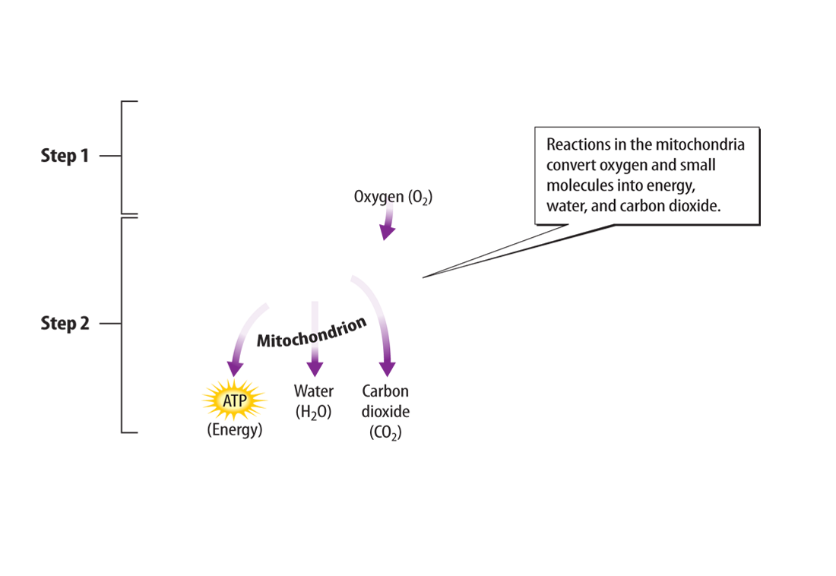
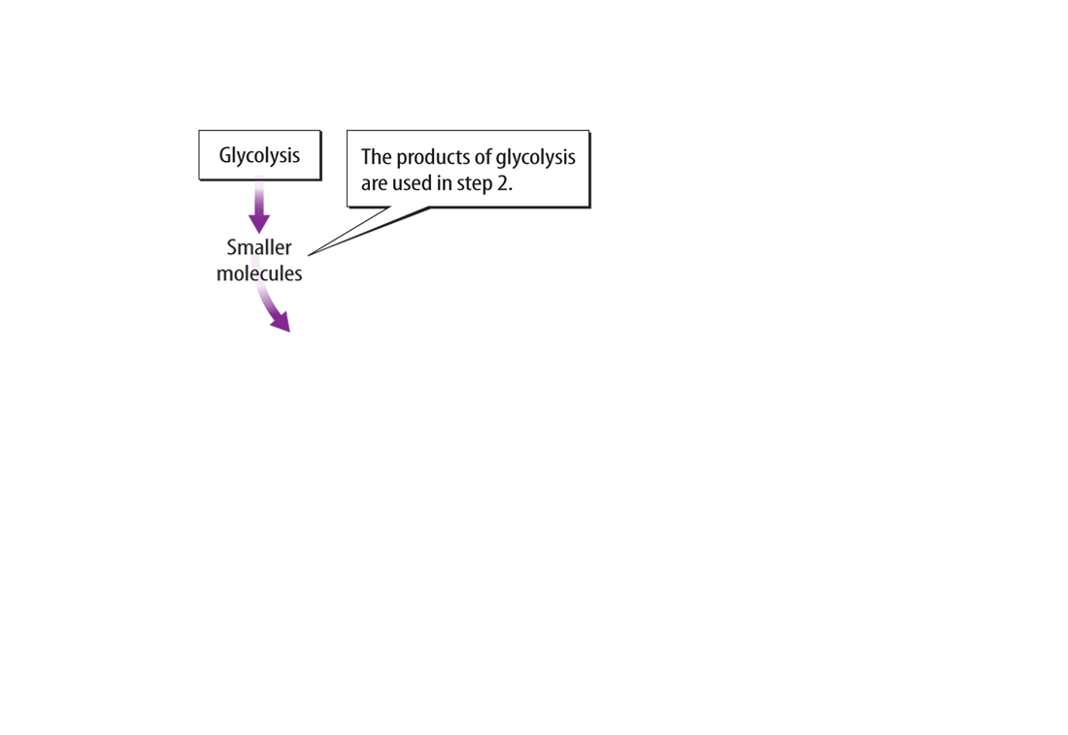
Lesson 4
Reactions in the Mitochondria

Slide 82
Lesson 4
Fermentation
Fermentation is a reaction that eukaryotic and prokaryotic cells use to obtain energy from food when oxygen levels are low.
Fermentation occurs in a cell’s cytoplasm, not in mitochondria.

Slide 83
Lesson 4
Fermentation (cont.)
Lactic acid is produced as waste during lactic-acid fermentation. Carbon dioxide and alcohol are produced as waste during alcohol fermentation.

Slide 84
Lesson 4
Fermentation (cont.)
How does a cell obtain energy?

Slide 85
Lesson 4
Photosynthesis
Photosynthesis is a series of chemical reactions that convert light energy, water, and CO₂ into the food-energy molecule glucose and give off oxygen.
photosynthesis
from Greek photo, means “light”; and synthesis, means “composition”

Slide 86
Lesson 4
Photosynthesis (cont.)
The chemical reactions of photosynthesis are powered by light energy.
In the chloroplasts of plants, pigments such as chlorophyll absorb light energy
Chlorophyll absorbs all colors except green light, which is reflected as the green color in leaves.

Slide 87
Lesson 4
Photosynthesis (cont.)
How do some cells make food molecules?

Slide 88
Lesson 4
Photosynthesis (cont.)
When an organism eats plant material it takes in food energy from the plant’s glucose.
An organism’s cells use the oxygen released during photosynthesis and convert the food energy into usable energy through cellular respiration.

Slide 89
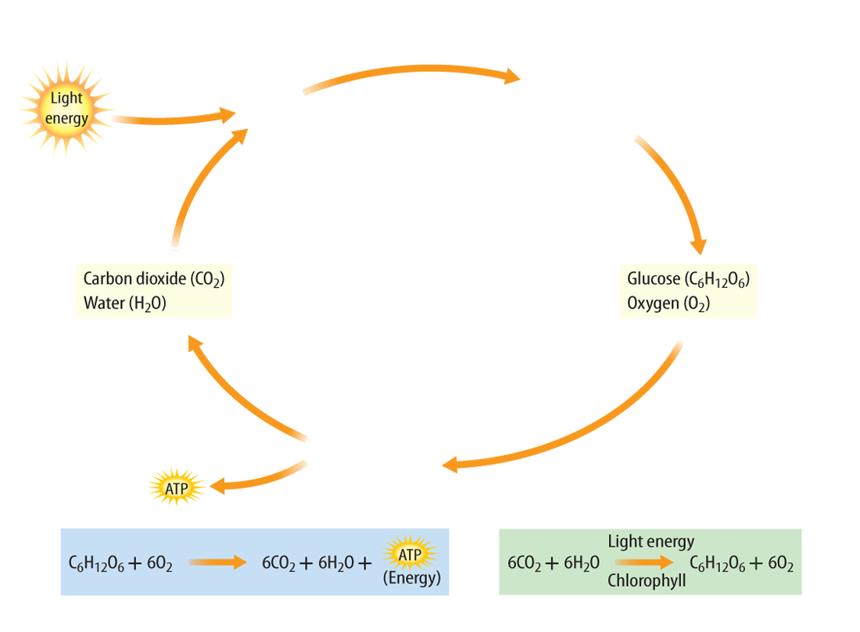
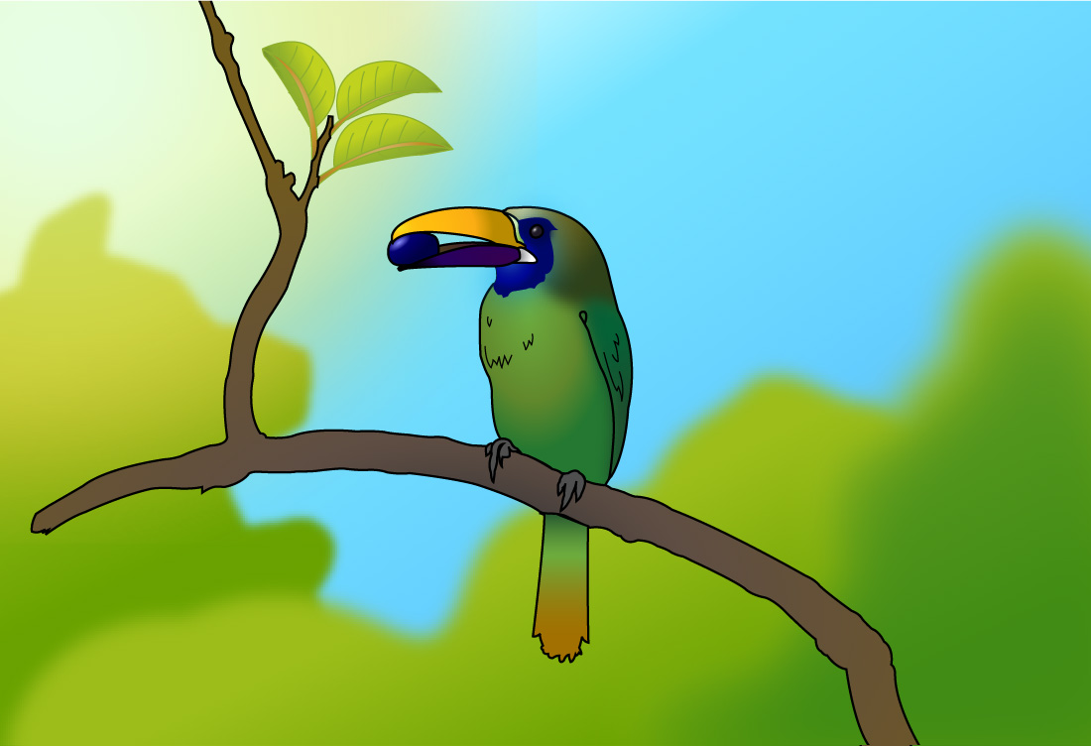
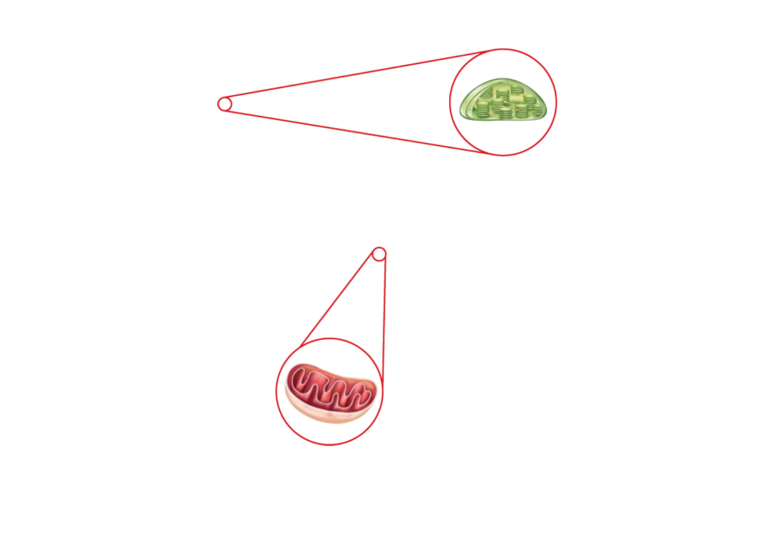
Lesson 4

Slide 90
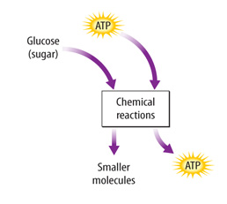
Lesson 4
Glycolysis is the first step in cellular respiration.

Slide 91
Lesson 4
Fermentation provides cells, such as muscle cells, with energy when oxygen levels are low.

Slide 92
Lesson 4
Light energy powers the chemical reactions of photosynthesis.

Slide 93
Lesson 4
What does cellular respiration convert the energy in food molecules into?
A. ATP
B. glucose
C. lactic acid
D. carbon dioxide

Slide 94
Lesson 4
Eukaryotic and prokaryotic cells use fermentation to obtain energy from what?
A. water
B. food
C. oxygen
D. pigments

Slide 95
Lesson 4
What chemical reactions converts light energy, water, and CO₂ into the food-energy molecule glucose?
A. lactic-acid fermentation
B. cellular respiration
C. alcohol fermentation
D. photosynthesis

Slide 96
Lesson 4
Do you agree or disagree?
7. ATP is the only form of energy found in cells.
8. Cellular respiration occurs only in lung cells.

Slide 97
Chapter Review Menu
Key Concept Summary
Interactive Concept Map
Chapter Review
Standardized Test Practice

Slide 98
The BIG Idea
A cell is made up of various structures that are essential for growth, reproduction, and homeostasis. They provide support and movement, process energy, and transport materials.

Slide 99
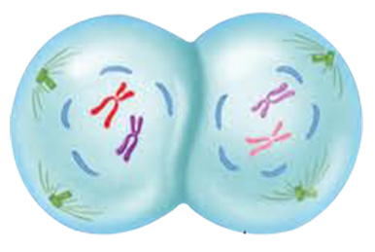
Key Concepts 1
Lesson 1: Cells and Life
The invention of the microscope led to discoveries about cells. In time, scientists used these discoveries to develop the cell theory, which explains how cells and living things are related.
Cells are composed mainly of water, proteins, nucleic acids, lipids, and carbohydrates.

Slide 100
Key Concepts 2
Lesson 2: The Cell
Cell structures have specific functions, such as supporting a cell, moving a cell, controlling cell activities, processing energy, and transporting molecules.
A prokaryotic cell lacks a nucleus and other membrane-bound organelles, while a eukaryotic cell has a nucleus and other membrane-bound organelles.

Slide 101
Key Concepts 3
Lesson 3: Cellular Material
Materials enter and leave a cell through the cell membrane using passive transport or active transport.
The ratio of surface area to volume limits the size of a cell. In a smaller cell, the high surface-area-to-volume ratio allows materials to move easily to all parts of a cell.

Slide 102
Key Concepts 4
Lesson 4: Cells and Energy
All living cells release energy from food molecules through cellular respiration and/or fermentation.
Some cells make food molecules using light energy through the process of photosynthesis.

Slide 103
Chapter Review - MC
Which of these store energy, provide structural support, and are needed for communication between cells?
A. sugars
B. lipids
C. proteins
D. carbohydrates

Slide 104
Chapter Review - MC
What are the membrane-surrounded components of eukaryotic cells that perform specialized functions?
A. cell walls C. ribosomes
B. DNA D. organelles

Slide 105
Chapter Review - MC
What is the term for the movement of substances from an area of higher concentration in a cell to an area of lower concentration?
A. active transport
B. osmosis
C. diffusion
D. passive transport

Slide 106
Chapter Review - MC
Which of these describes the process during which a cell takes in a substance by surrounding it with a cell membrane?
A. endocytosis
B. osmosis
C. exocytosis
D. diffusion

Slide 107
Chapter Review - MC
Pigments like chlorophyll absorb light energy during which process?
A. endocytosis
B. active transport
C. photosynthesis
D. osmosis

Slide 108
Chapter Review - MC
Which part of a cell contains genetic information?
A. nucleic acids
B. amino acid molecules
C. proteins
D. carbohydrates

Slide 109
Chapter Review - MC
What is the fluid inside a cell that contains salts and other molecules?
A. protein
B. water
C. cytoplasm
D. flagella

Slide 110
Chapter Review - MC
What does facilitated diffusion require to pass molecules through a cell membrane?
A. water
B. glucose
C. light energy
D. transport proteins

Slide 111
Chapter Review - MC
During which process do cells take in needed nutrients from the environment through carrier proteins?
A. endocytosis
B. active transport
C. exocytosis
D. passive transport

Slide 112
Chapter Review - MC
What type of fermentation do some types of bacteria and yeast use to produce ethanol and CO₂?
A. alcohol fermentation
B. lactic acid fermentation
C. yeast fermentation
D. molecular fermentation

