Slide 1



SCIENCE
LET’S INVESTIGATE: The Scientific Method

Slide 2
The Scientific Method? What’s it all about?

Slide 3
What is the Scientific Method?
It is the steps someone takes to identify a question, develop a hypothesis, design and carry out steps or procedures to test the hypothesis, write down data, and draw a conclusion.
In other words, it’s a way to solve a problem.

Slide 4

Think like a scientist...
Scientists take time to think logically when they are investigating a question or problem.
They break things down into many steps that make sense.

Slide 5

Steps of the Scientific Method
Ask a QUESTION or identify a problem.
Gather information and form a HYPOTHESIS.
Create an EXPERIMENT to test your hypothesis.
Collect DATA and OBSERVATIONS by doing the experiment.
Draw a CONCLUSION.
SHARE your findings.
https://www.youtube.com/watch?v=qAJ8IF4HI20

Slide 6

Asking questions
Does exercise make your heart beat faster?
Do plants need water to grow?
All investigations start with a question !

Slide 7
What question could these children be investigating?
What are they predicting will happen?

Slide 8

I predict that...
A HYPOTHESIS is the same thing as a prediction. It is an EDUCATED GUESS or what you think is going to happen in your experiment.
Example: I think that the metal items will be the best conductors of electricity.

Slide 9
Because...
You need to give a reason why your hypothesis is correct.
Example: …..because metal is used in wires in my home.

Slide 10
What are these two finely dressed children investigating?
https://www.youtube.com/watch?v=QyeF-_QPSbk
What is their HYPOTHESIS?

Slide 11
The next step scientists take is to create and conduct an experiment to test their hypothesis.
Designing an experiment...

Slide 12

I will change...
In every experiment, we
change 1 thing, this is
called a variable.
Example: I will only change the kind of metal used in my experiment to test which is a better conductor of electricity.

Slide 13

How do I make it a fair test?
A fair test is when we keep everything the same except the variable. (one thing we change)
Example: I will only change the kind of metal used in my experiment to test which is a better conductor of electricity.

Slide 14
What are these children investigating?
What do you think is their variable? How did they make it a fair test?

Slide 15
A key to experiments is observing what happens and writing it down.
After doing the experiment...
Gathering information or data is very important. Write it down so it is readable and makes sense to other people who read it.

Slide 16

What are the results of my experiment?
After the experiment, you need to write in detail what happened in your experiment.
Example: What happened? The materials that were made out of metal made the bulb light up brightly. However, the materials that were not made out of metal did not make the bulb light at all.

Slide 17
How do I draw a conclusion?
Your hypothesis
does not have to
be correct!!
You need to look back at your HYPOTHESIS and see if you were correct!
Example: Are your results what you predicted? Yes, I thought that metals would be the best conductors of electricity and the results of my experiment proved that this was true.

Slide 18
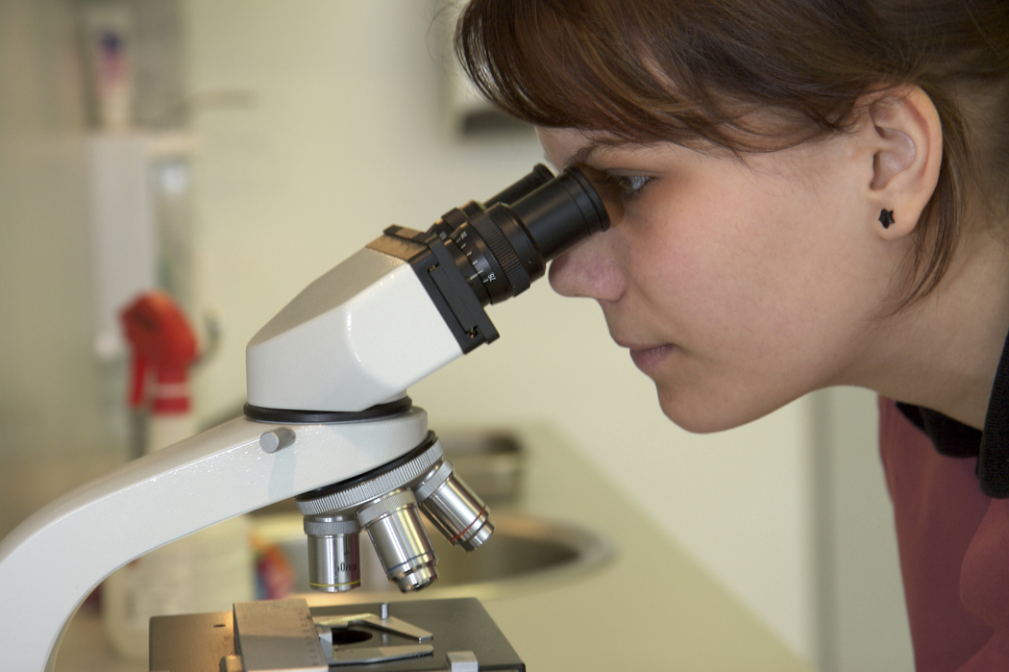
Explain why your hypothesis was correct or not.
You need to explain (give reasons why) your hypothesis was right or wrong.
Example: All of the materials that were metal made the bulbs light. All of the materials that weren’t metal did not, except for the pencil lead.

Slide 19

Once a scientist completes an experiment, they often repeat it to see if they get the same findings and results.
Repeat, repeat, repeat...
This is really what we call verification, or checking things out to make sure everything is valid and will happen again and again.

Slide 20
Scientists share their experiments and findings with others.
Make sure to share!
https://www.youtube.com/watch?v=T8427L0Wry0
Scientists can learn from each other and often use someone else’s experiences to help them with what they are studying or doing.

