Slide 1
Chapter Menu
Chapter 3
From a Cell to an Organism

Slide 2
Chapter Menu
Chapter Introduction
Lesson 1 The Cell Cycle and Cell Division
Lesson 2 Levels of Organization
Chapter Wrap-Up

Slide 3
Chapter Introduction
How can one cell become a multicellular organism?

Slide 4
Chapter Introduction
What do you think?
Before you begin, decide if you agree or disagree with each of these statements. As you view this presentation, see if you change your mind about any of the statements.

Slide 5
Chapter Introduction
Do you agree or disagree?
1. Cell division produces two identical cells.
2. Cell division is important for growth.
3. At the end of the cell cycle, the original cell no longer exists.

Slide 6
Chapter Introduction
Do you agree or disagree?
4. Unicellular organisms do not have all the characteristics of life.
5. All the cells in a multicellular organism are the same.
6. Some organs work together as part of an organ system.

Slide 7
Lesson 1 Reading Guide
The Cell Cycle and Cell Division
What are the phases of the cell cycle?
Why is the result of the cell cycle important?

Slide 8
Lesson 1 Reading Guide - Vocab
The Cell Cycle and Cell Division
cell cycle
interphase
sister chromatid
centromere
mitosis
cytokinesis
daughter cells

Slide 9
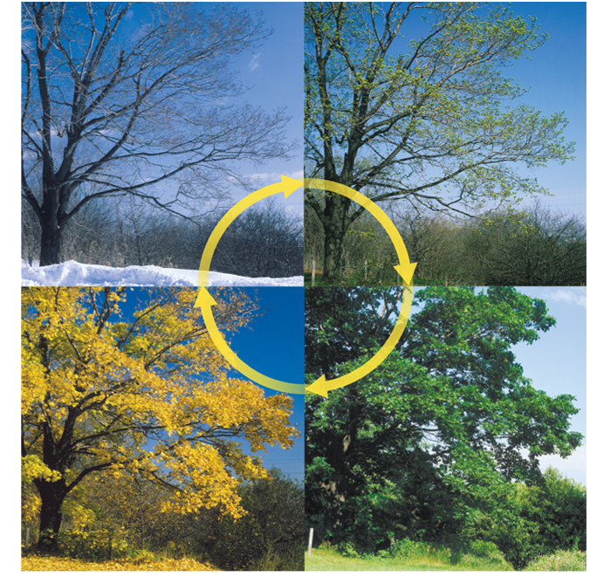
Lesson 1
The Cell Cycle
Cycles occur in nature.
The life cycles of living organisms such as trees are affected by the change in seasons.
Bill Brooks/Alamy

Slide 10
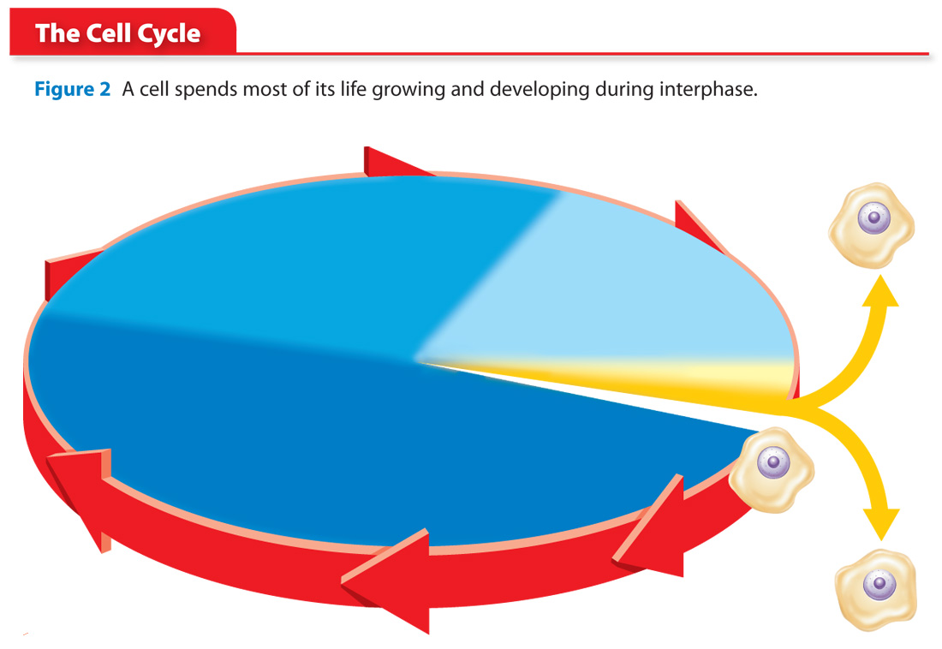
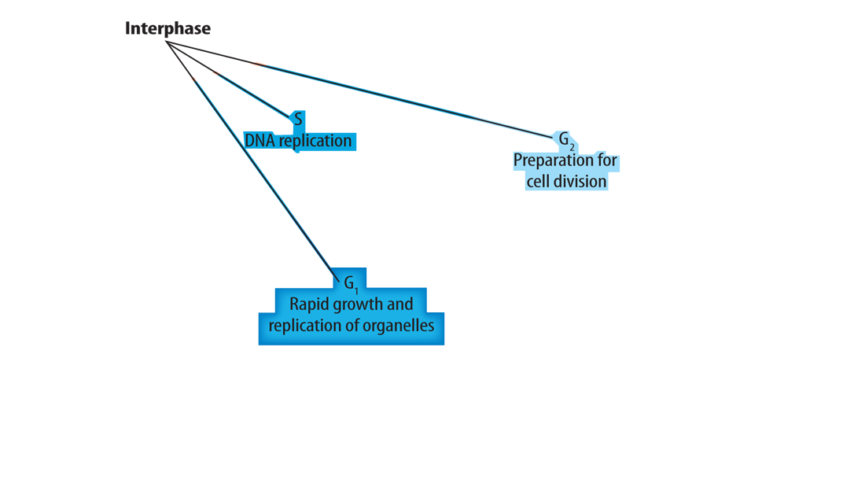
Lesson 1
The Cell Cycle (cont.)
Most cells in an organism go through a cycle of growth, development, and division called the cell cycle.
There are two main phases in the cell cycle—interphase and the mitotic phase.

Slide 11
Lesson 1
The Cell Cycle (cont.)
What are the two main phases of the cell cycle?

Slide 12
Lesson 1
Interphase
Interphase occurs in three stages: G₁, S, and G₂.

Slide 13
Lesson 1
Interphase (cont.)
The cell’s DNA is copied during the S stage and is arranged as pairs of identical chromosomes called sister chromatids.
Sister chromatids are held together by a structure called the centromere.

Slide 14
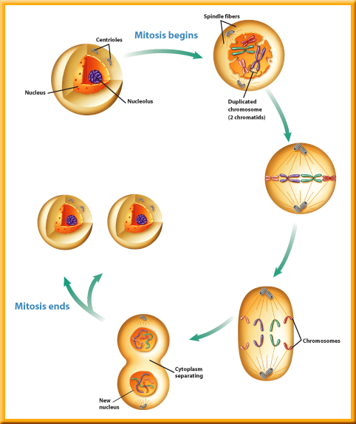
Lesson 1
The Mitotic Phase
During mitosis, the contents of the nucleus divide, forming two identical nuclei.

Slide 15
Lesson 1
The Mitotic Phase (cont.)
mitosis
from Greek mitos, means “wrap thread”; and Latin –osis, means “process”

Slide 16
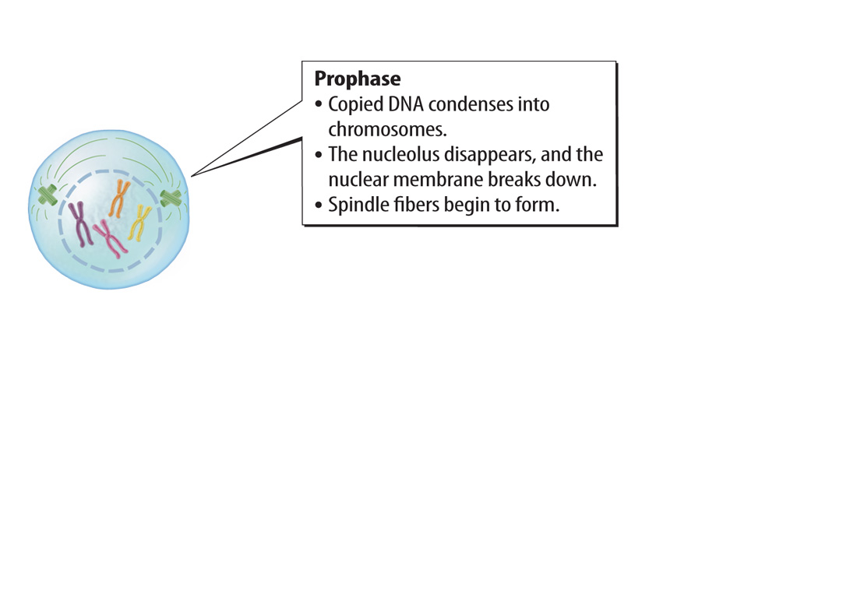
Lesson 1
The Mitotic Phase (cont.)

Slide 17
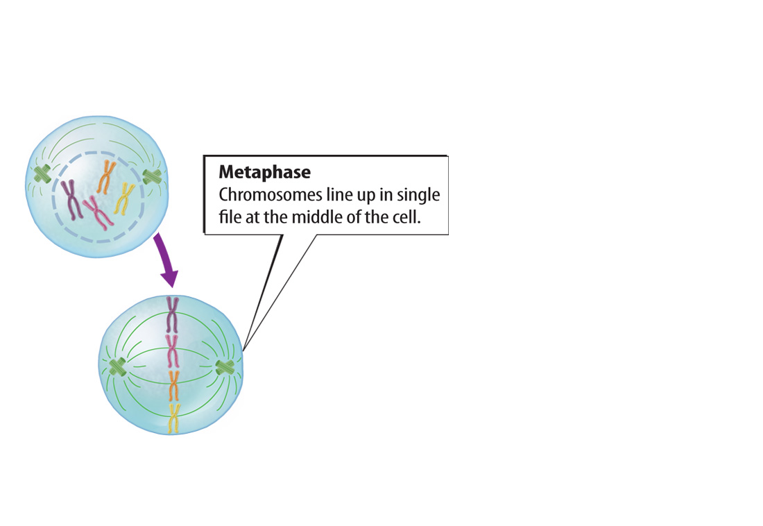
Lesson 1
The Mitotic Phase (cont.)

Slide 18
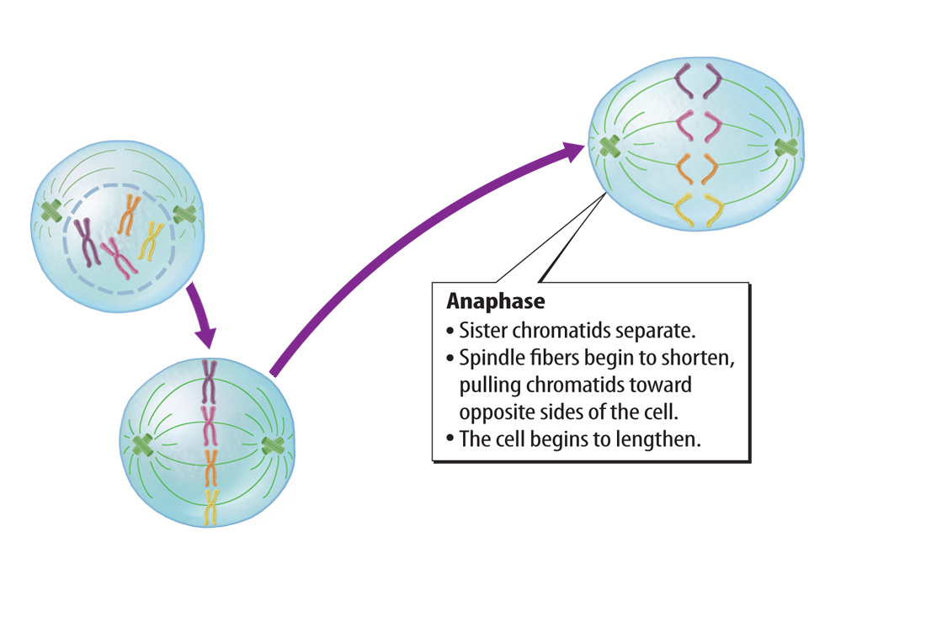
Lesson 1
The Mitotic Phase (cont.)

Slide 19
Lesson 1
The Mitotic Phase (cont.)

Slide 20
Lesson 1
The Mitotic Phase (cont.)
In cytokinesis, the cytoplasm divides and forms two new daughter cells.

Slide 21
Lesson 1
Results of Cell Division
The cell cycle is important for reproduction in some organisms, growth in multicellular organisms, replacement of worn out or damaged cells, and repair of damaged tissues.
In some unicellular organisms, cell division is a form of reproduction.
Cell division allows multicellular organisms to grow and develop from one cell.

Slide 22
Lesson 1
Results of Cell Division (cont.)
Why is the result of the cell cycle important?

Slide 23
Lesson 1
During interphase, most cells go through periods of rapid growth and replication of organelles, copying DNA, and preparation for cell division.

Slide 24
Lesson 1
The nucleus and its contents divide during mitosis.
The cytoplasm and its contents divide during cytokinesis.

Slide 25
Lesson 1
What takes place during the S stage of interphase?
A. DNA replication
B. preparation for cell division
C. rapid growth of organelles
D. division of the nucleus

Slide 26
Lesson 1
What are the two identical chromosomes that make up a duplicated chromosome called?
A. centromeres
B. coils
C. organelles
D. sister chromatids

Slide 27
Lesson 1
During which phase of mitosis do the duplicated chromosomes move to the middle of the cell?
A. prophase
B. metaphase
C. anaphase
D. telophase

Slide 28
Lesson 1
Do you agree or disagree?
1. Cell division produces two identical cells.
2. Cell division is important for growth.
3. At the end of the cell cycle, the original cell no longer exists.

Slide 29
Lesson 2 Reading Guide
Levels of Organization
How do unicellular and multicellular organisms differ?
How does cell differentiation lead to the organization within a multicellular organism?

Slide 30
Lesson 2 Reading Guide - Vocab
Levels of Organization
cell differentiation
stem cell
tissue
organ
organ system

Slide 31
Lesson 2
Unicellular Organisms
Unicellular organisms carry out all life processes, including responding to the environment, getting rid of waste, growing, and reproducing, within one cell.
A unicellular organism made of one prokaryotic cell is called a prokaryote.
A unicellular organism made of one eukaryotic cell is called a eukaryote.

Slide 32
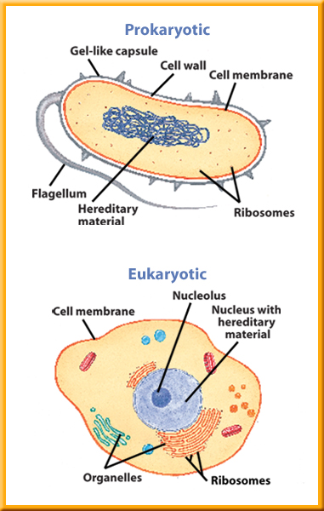
Lesson 2
Unicellular Organisms (cont.)
A cell without a membrane-bound nucleus is a prokaryotic cell.
A eukaryotic cell has a membrane-bound nucleus and many other specialized organelles.

Slide 33
Lesson 2
Multicellular Organisms
Multicellular organisms are made of many types of eukaryotic cells working together, each with a specialized function.
How do unicellular and multicellular organisms differ?

Slide 34
Lesson 2
Multicellular Organisms (cont.)
All cells in a multicellular organism come from one cell: a fertilized egg.
The process by which cells become different types of cells is called cell differentiation.

Slide 35
Lesson 2
Multicellular Organisms (cont.)
Stem cells are unspecialized animal cells that are able to develop into many different cell types.
fiber
Science Use a long muscle cell
Common Use a thread

Slide 36
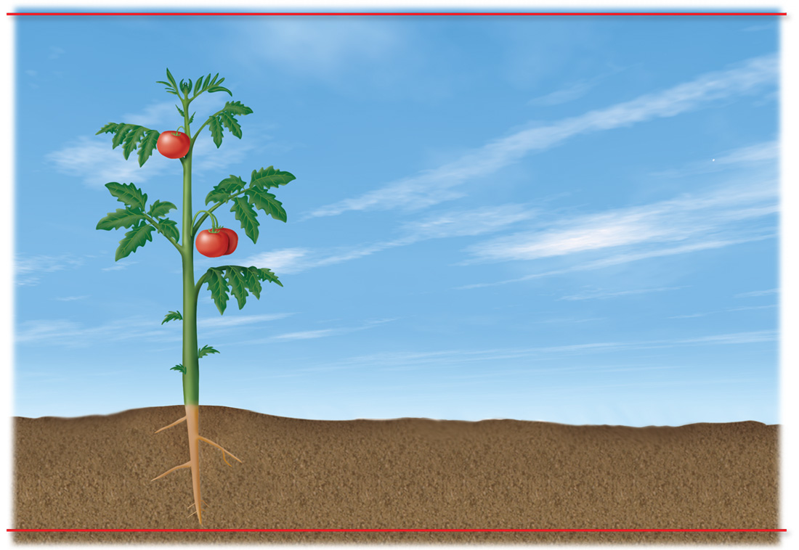
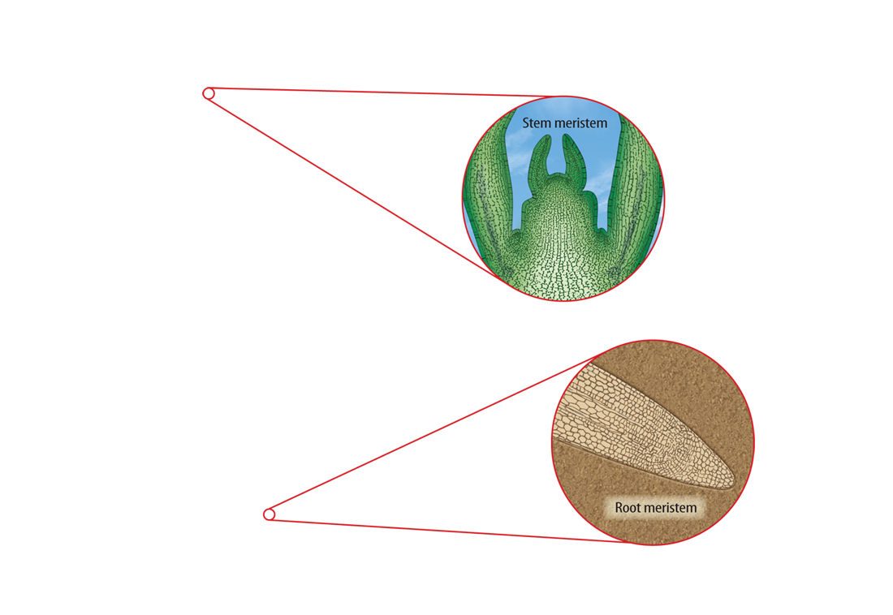
Lesson 2
Multicellular Organisms (cont.)
Plants have unspecialized cells similar to animal stem cells.
These cells are grouped in areas of a plant called meristems.

Slide 37
Lesson 2
Multicellular Organisms (cont.)
Tissues are groups of similar types of cells in multicellular organisms that work together to carry out specific tasks.
tissue
from Latin texere, means “weave”

Slide 38
Lesson 2
Multicellular Organisms (cont.)
Humans, like most other animals, have four main types of tissue: muscle, connective, nervous, and epithelial.
The three main types of plant tissue are dermal, vascular, and ground tissue.

Slide 39
Lesson 2
Multicellular Organisms (cont.)
Organs are groups of different tissues working together to perform a particular job.
Organ systems are groups of different organs that work together to complete a series of tasks.

Slide 40
Lesson 2
Multicellular Organisms (cont.)
Multicellular organisms usually have many organ systems that work together to carry out all the jobs needed for the survival of the organism.
How does cell differentiation lead to the organization within a multicellular organism?

Slide 41
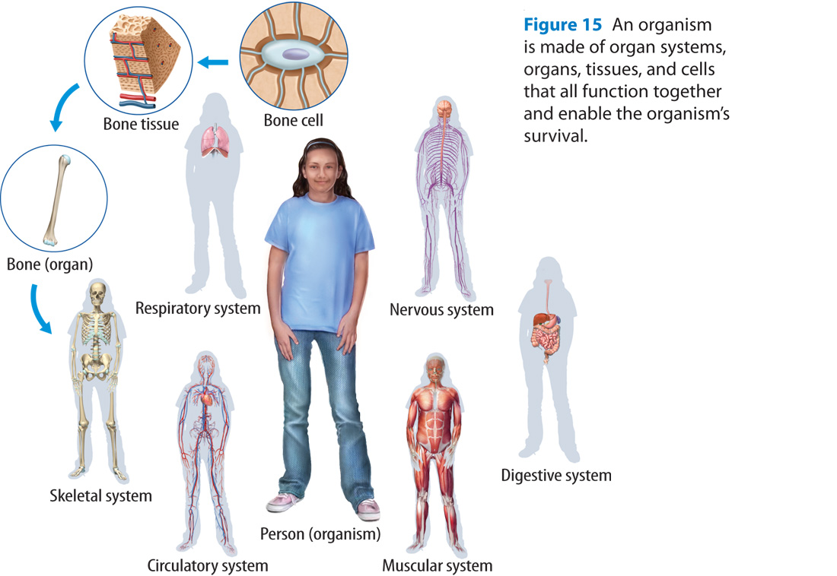
Lesson 2

Slide 42
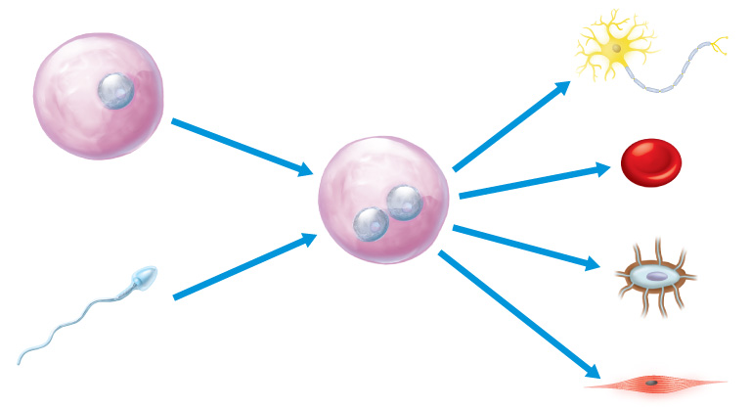
Lesson 2
A unicellular organism carries out all the activities necessary for survival within one cell.
Cells become specialized in structure and function during cell differentiation.

Slide 43
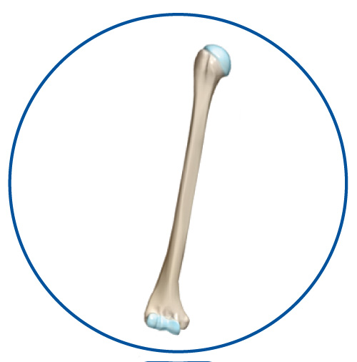
Lesson 2
Organs are groups of different tissues that work together to perform a job.

Slide 44
Lesson 2
What is the process by which cells become specialized?
A. photosynthesis
B. vascular development
C. prokaryotic process
D. cell differentiation

Slide 45
Lesson 2
What are the unspecialized animal cells capable of developing into many different cell types?
A. fibers
B. stem cells
C. meristems
D. tissues

Slide 46
Lesson 2
What is the term for groups of different organs that work together to complete a series of tasks?
A. tissues
B. organisms
C. organ systems
D. stem cells

Slide 47
Lesson 2
Do you agree or disagree?
4. Unicellular organisms do not have all the characteristics of life.
5. All the cells in a multicellular organism are the same.
6. Some organs work together as part of an organ system.

Slide 48
The BIG Idea
Through various physiological functions essential for growth and reproduction, one cell can grow and develop into a multicellular organism.

Slide 49
Key Concepts 1
Lesson 1: The Cell Cycle and Cell Division
The cell cycle consists of two phases. During interphase, a cell grows and its chromosomes and organelles replicate. During the mitotic phase of the cell cycle, the nucleus divides during mitosis, and the cytoplasm divides during cytokinesis.
The cell cycle results in two genetically identical daughter cells. The original parent cell no longer exists.

Slide 50
Key Concepts 1
Lesson 1: The Cell Cycle and Cell Division (cont.)
The cell cycle is important for growth in multicellular organisms, reproduction in some organisms, replacement of worn-out cells, and repair of damaged cells.

Slide 51
Key Concepts 2
Lesson 2: Levels of Organization
The one cell of a unicellular organism is able to obtain all the materials that it needs to survive.
In a multicellular organism, cells cannot survive alone and must work together to provide the organism’s needs.
Through cell differentiation, cells become different types of cells with specific functions. Cell differentiation leads to the formation of tissues, organs, and organ systems.

Slide 52
Chapter Review - MC
Which phase of the cell cycle includes the cell’s growth and development?
A. Cytokinesis
B. Mitosis
C. Interphase
D. Metaphase

Slide 53
Chapter Review - MC
What structure holds sister chromatids together?
A. daughter chromatids
B. cytoplasm
C. organelles
D. centromere

Slide 54
Chapter Review - MC
What process do cells go through to become different types of cells?
A. molecular differentiation
B. cellular organization
C. cell differentiation
D. tissue differentiation

Slide 55
Chapter Review - MC
What are the three main types of plant tissue?
A. vascular, muscle, connective
B. dermal, connective, muscle
C. epithelial, ground, muscle
D. dermal, vascular, ground

Slide 56
Chapter Review - MC
Which of the following is an example of an organ system?
A. brain
B. circulatory system
C. foot
D. liver

Slide 57
Chapter Review - MC
During which stage does a cell experience growth and chromosome replication?
A. S
B. G
C. G₁
D. G₂

Slide 58
Chapter Review - MC
During which stage do the nucleus and its contents divide?
A. anaphase
B. interphase
C. mitosis
D. cytokinesis

Slide 59
Chapter Review - MC
During which phase of mitosis does a nuclear membrane grow, forming two identical nuclei?
A. anaphase
B. telophase
C. prophase
D. metaphase

Slide 60
Chapter Review - MC
What is a group of similar types of cells that work together to carry out specific tasks called?
A. organ
B. stem cell
C. organ system
D. tissue

Slide 61
Chapter Review - MC
What is a group of different tissues working together to perform a particular job?
A. organ system
B. dermal tissue
C. organ
D. vascular tissue

