Slide 1
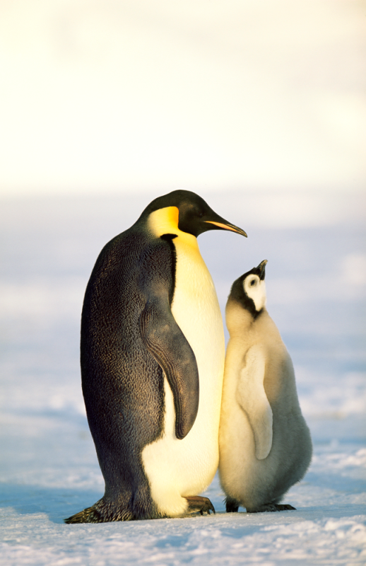
Chapter Menu
Chapter Introduction
Lesson 1 Sexual Reproduction and Meiosis
Lesson 2 Asexual Reproduction
Chapter Wrap-Up
Digital Vision Ltd./SuperStock

Slide 2
Chapter Introduction
Why do living things reproduce?

Slide 3
Chapter Introduction
What do you think?
Before you begin, decide if you agree or disagree with each of these statements. As you view this presentation, see if you change your mind about any of the statements.

Slide 4
Chapter Introduction
Do you agree or disagree?
1. Humans produce two types of cells: body cells and sex cells.
2. Environmental factors can cause variation among individuals.
3. Two parents always produce the best offspring.

Slide 5
Chapter Introduction
Do you agree or disagree?
4. Cloning produces identical individuals from one cell.
5. All organisms have two parents.
6. Asexual reproduction occurs only in microorganisms.

Slide 6
Lesson 1 Reading Guide
Sexual Reproduction and Meiosis
What is sexual reproduction, and why is it beneficial?
What is the order of the phases of meiosis, and what happens during each phase?
Why is meiosis important?

Slide 7
Lesson 1 Reading Guide - Vocab
Sexual Reproduction and Meiosis
sexual reproduction
egg
sperm
fertilization
zygote
diploid
homologous chromosomes
haploid
meiosis

Slide 8
Lesson 1
What is sexual reproduction?
Sexual reproduction is a type of reproduction in which the genetic materials from two different cells combine, producing an offspring.
The female sex cell, an egg, forms in an ovary.
The male sex cell, a sperm, forms in the testis.

Slide 9
Lesson 1
What is sexual reproduction? (cont.)
During a process called fertilization, an egg cell and a sperm cell join together to create a zygote.

Slide 10
Lesson 1
Diploid Cells
Organisms that reproduce sexually form body cells and sex cells.
In body cells of most organisms, similar chromosomes occur in pairs.
Diploid cells are cells that have pairs of chromosomes.

Slide 11
Lesson 1
Diploid Cells (cont.)
Pairs of chromosomes that have genes for the same traits arranged in the same order are called homologous chromosomes.
Because one chromosome is inherited from each parent, the chromosomes are not identical.
Different organisms have different numbers of chromosomes.

Slide 12
Lesson 1

Slide 13
Lesson 1
Haploid Cells
Haploid cells are cells that have only one chromosome from each pair of chromosomes.
haploid
from Greek haploeides, means “single”

Slide 14
Lesson 1
Haploid Cells (cont.)
In meiosis, one diploid cell divides and makes four haploid sex cells.
Meiosis occurs only during the formation of sex cells.
Meiosis involves two divisions of the nucleus, meiosis I and meiosis II.
A reproductive cell goes through interphase before beginning meiosis I.

Slide 15
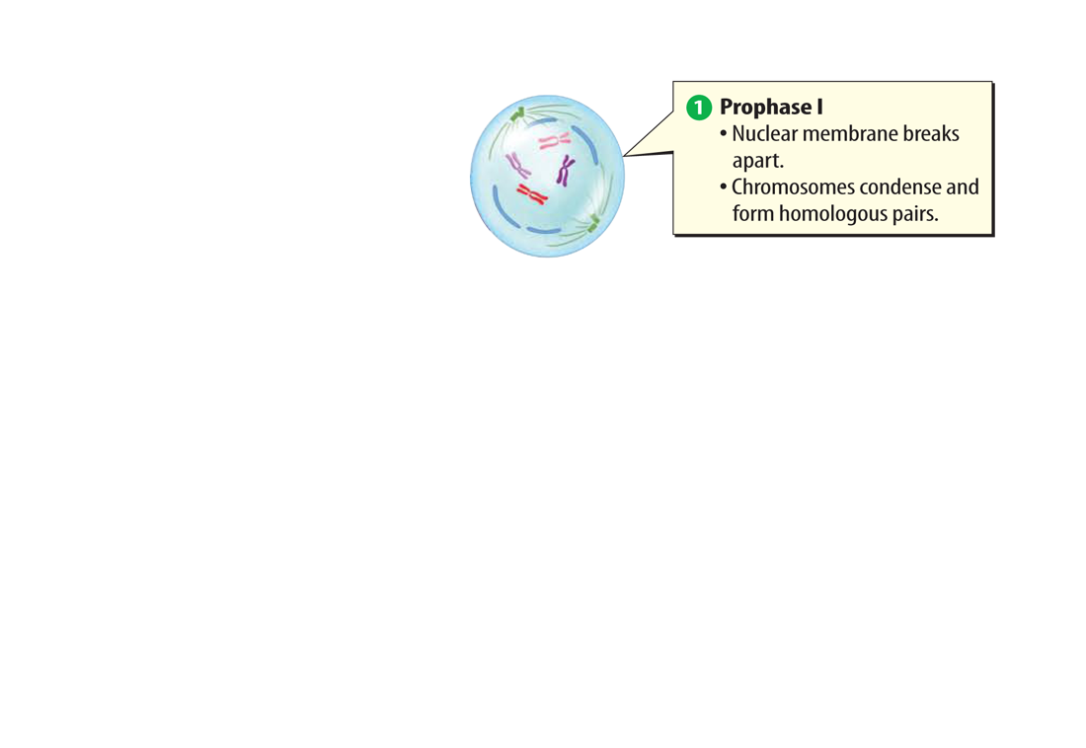
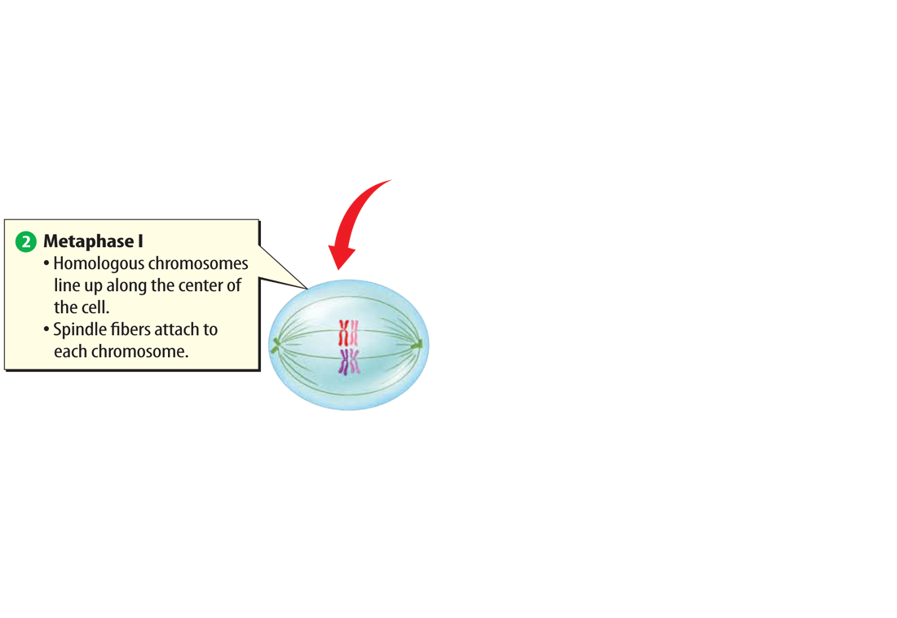
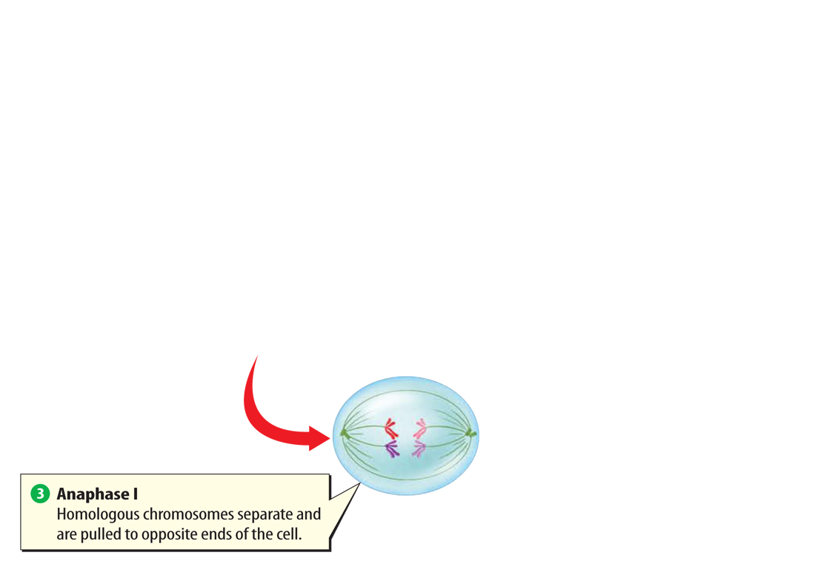
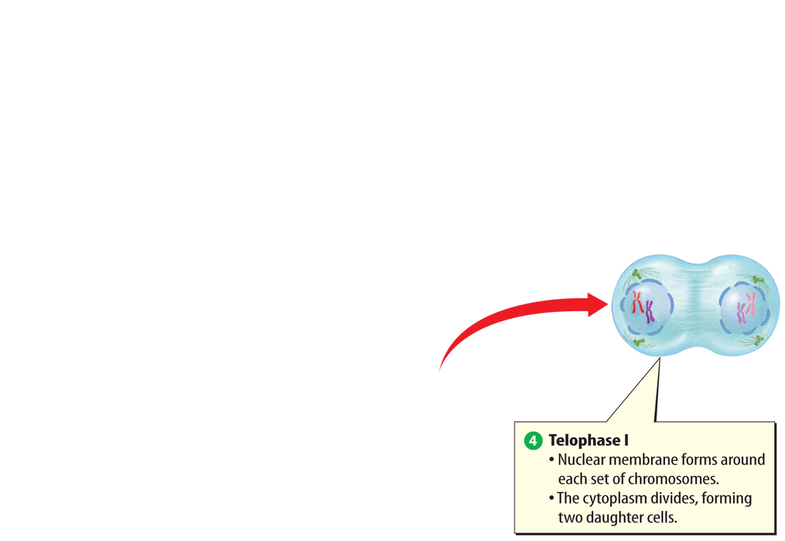
Lesson 1
The Phases of Meiosis (cont.)
There are four phases of meiosis I.

Slide 16
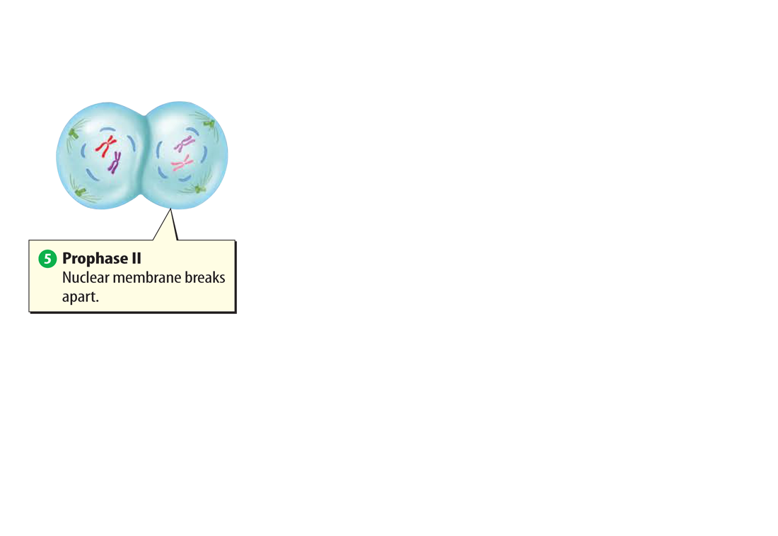
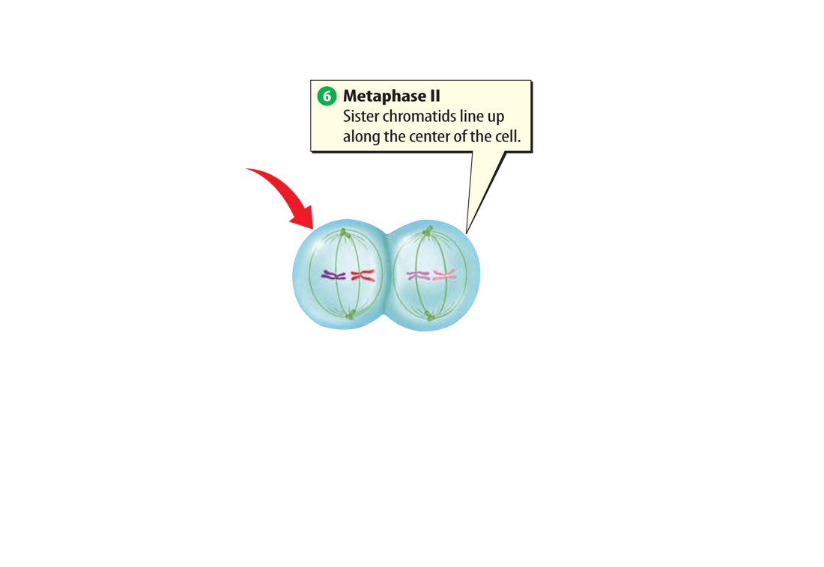
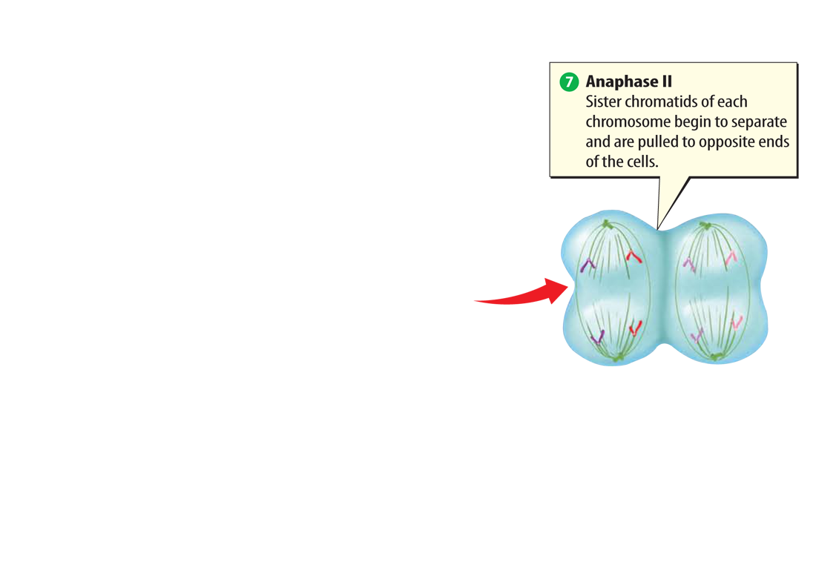
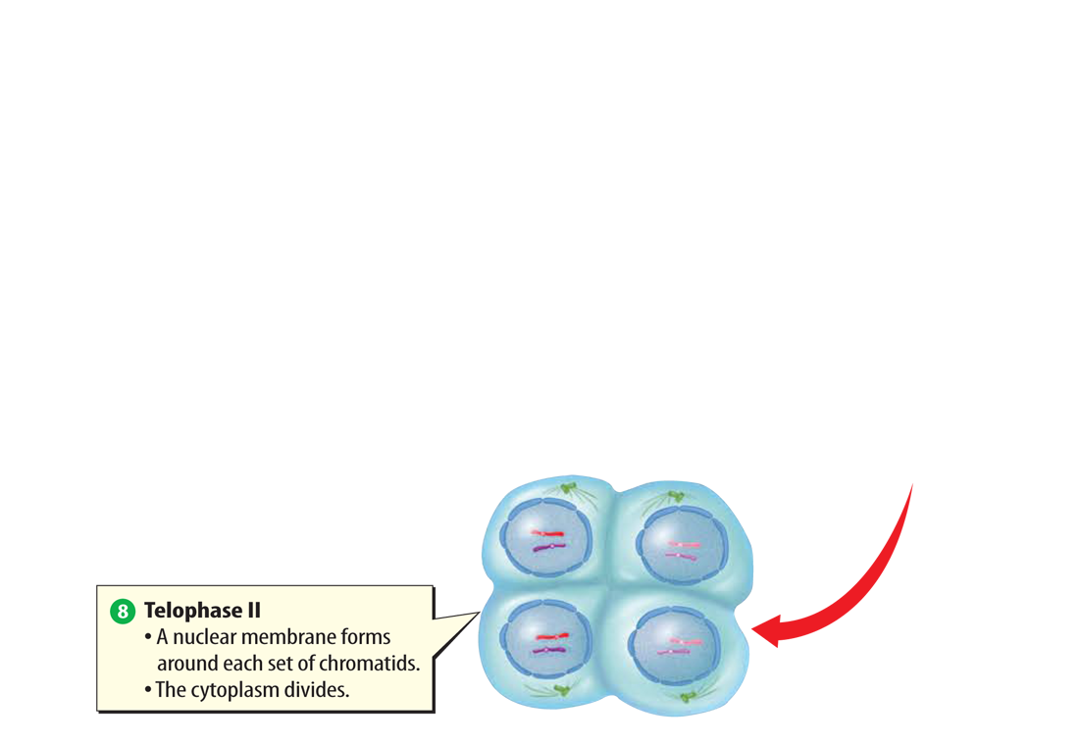
Lesson 1
The Phases of Meiosis (cont.)
There are four phases of meiosis II.

Slide 17
Lesson 1
The Phases of Meiosis (cont.)
List the phases of meiosis in order.

Slide 18
Lesson 1
Why is meiosis important?
Meiosis forms sex cells with the correct haploid number of chromosomes.
Meiosis also creates genetic variation by producing haploid cells.
When haploid sex cells join together during fertilization, they make a diploid zygote, or fertilized egg.

Slide 19
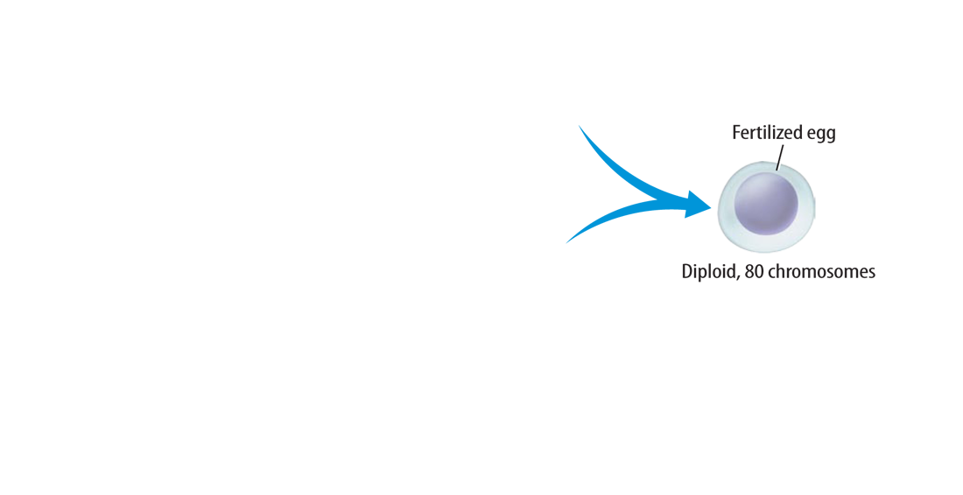
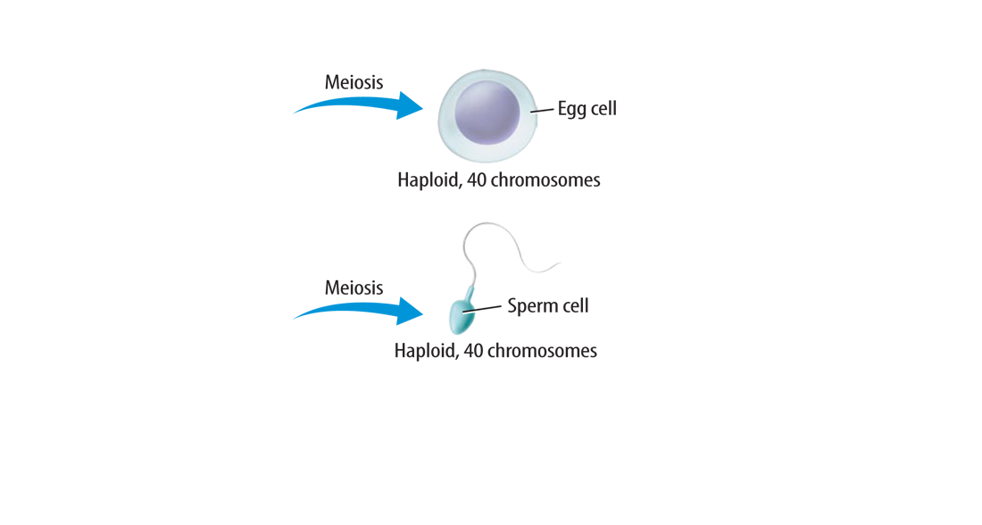
Lesson 1
Why is meiosis important? (cont.)
The fertilized egg, formed when sex cells join together, divides by mitosis to create a diploid organism.

Slide 20
Lesson 1
Why is meiosis important? (cont.)
Why is meiosis important?

Slide 21
Lesson 1
How do mitosis and meiosis differ?
During mitosis and cell division, a body cell and its nucleus divide once and produce two identical cells.
The two daughter cells produced by mitosis and cell division have the same genetic information.

Slide 22
Lesson 1
How do mitosis and meiosis differ? (cont.)
During meiosis, a reproductive cell and its nucleus divide twice and produce four cells—two pairs of identical haploid cells.
Meiosis forms sex cells used for sexual reproduction.

Slide 23
Lesson 1

Slide 24
Lesson 1
Advantages of Sexual Reproduction
Genetic variation occurs in all organisms that reproduce sexually.
Due to genetic variation, individuals within a population have slight differences.

Slide 25
Lesson 1
Advantages of Sexual Reproduction (cont.)
Genetic variation may enable one plant to be more disease-resistant than another within the same species.

Slide 26
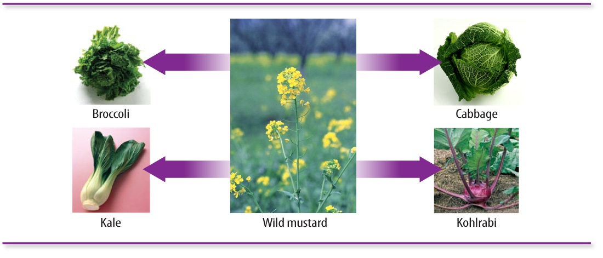
Lesson 1
Advantages of Sexual Reproduction (cont.)
Selective breeding has been used to develop many types of plants and animals with desirable traits.
Stockbyte/Getty Images
Ingram Publishing/ SuperStock
Medioimages/PunchStock
image100/SuperStock
Wally Eberhart/Visuals Unlimited/Getty Images

Slide 27
Lesson 1
Advantages of Sexual Reproduction (cont.)
Why is sexual reproduction beneficial?

Slide 28
Lesson 1
Disadvantages of Sexual Reproduction
Organisms have to grow and develop until they are mature enough to produce sex cells.
Organisms must form sex cells—either eggs or sperm.

Slide 29
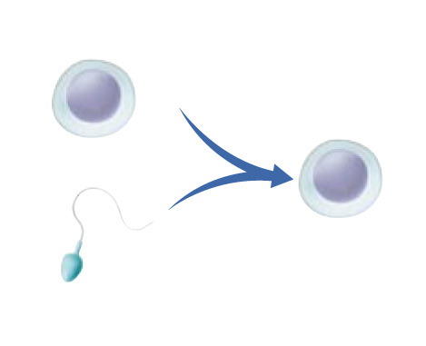
Lesson 1
Fertilization occurs when an egg cell and a sperm cell join together.

Slide 30
Lesson 1
Organisms produce sex cells through meiosis.

Slide 31
Lesson 1
Sexual reproduction results in genetic variation among individuals.
Digital Vision Ltd./SuperStock

Slide 32
Lesson 1
Cells that have pairs of chromosomes are called ____.
A. chromosomes
B. body cells
C. diploid cells
D. sex cells

Slide 33
Lesson 1
During which process does one diploid cell divide and make four haploid sex cells?
A. osmosis
B. fertilization
C. reproduction
D. meiosis

Slide 34
Lesson 1
During which phase of meiosis I do chromosome pairs separate and pull to opposite ends of the cell?
A. prophase I C. anaphase II
B. metaphase I D. anaphase I

Slide 35
Lesson 1
Do you agree or disagree?
1. Humans produce two types of cells: body cells and sex cells.
2. Environmental factors can cause variation among individuals.
3. Two parents always produce the best offspring.

Slide 36
Lesson 2 Reading Guide
Asexual Reproduction
What is asexual reproduction, and why is it beneficial?
How do the types of asexual reproduction differ?

Slide 37
Lesson 2 Reading Guide - Vocab
Asexual Reproduction
asexual reproduction
fission
budding
regeneration
vegetative reproduction
cloning

Slide 38
Lesson 2
What is asexual reproduction?
In asexual reproduction, one parent organism produces offspring without meiosis and fertilization.
Because the offspring inherit all their DNA from one parent, they are genetically identical to each other and to their parent.

Slide 39
Lesson 2
What is asexual reproduction? (cont.)
Describe asexual reproduction in your own words.

Slide 40
Lesson 2
Types of Asexual Reproduction
Cell division in prokaryotes is known as fission.
fission
from Latin fissionem, means “a breaking up, cleaving”

Slide 41
Lesson 2
Types of Asexual Reproduction (cont.)
A prokaryote’s DNA molecule is copied and each copy attaches to the cell membrane.
The cell grows longer, pulling the two copies of DNA apart while the cell membrane begins to pinch inward along the middle of the cell.

Slide 42
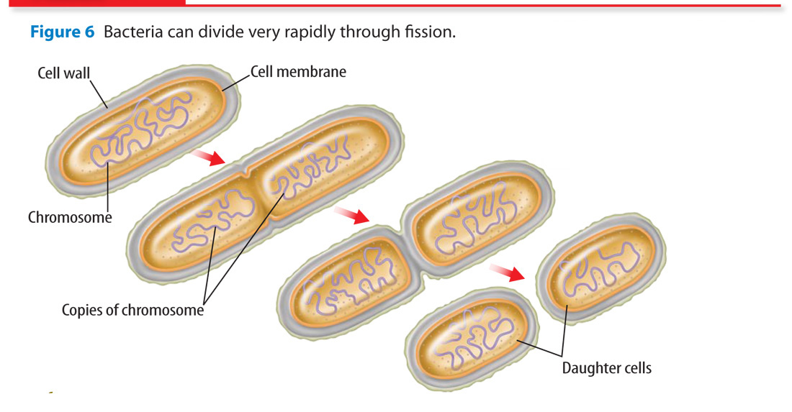
Lesson 2
Types of Asexual Reproduction (cont.)
Through fission, the cell splits and forms two new identical offspring.

Slide 43
Lesson 2
Types of Asexual Reproduction (cont.)
In mitotic cell division, one organism forms two genetically identical offspring through mitosis and cell division. Many unicellular eukaryotes reproduce in this way.
In budding, a new organism grows by mitosis and cell division on the body of its parent.
Budding produces offspring genetically identical to its parent.

Slide 44
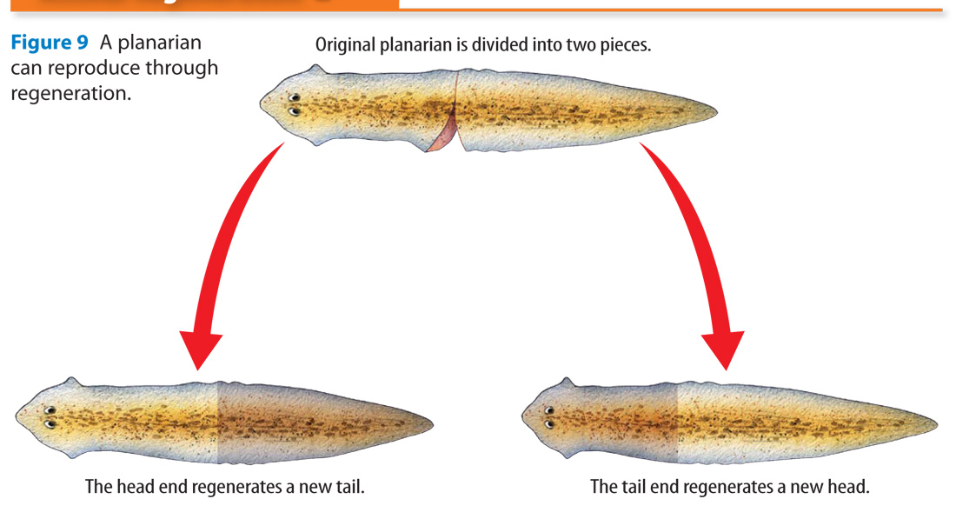
Lesson 2
Types of Asexual Reproduction (cont.)
Animal regeneration occurs when an offspring grows from a piece of its parent.

Slide 45
Lesson 2
Types of Asexual Reproduction (cont.)
Vegetative reproduction is a form of asexual reproduction in which offspring grow from a part of a parent plant.
Vegetative reproduction usually involves structures such as the roots, the stems, and the leaves of plants.

Slide 46
Lesson 2
Types of Asexual Reproduction (cont.)
Cloning is a type of asexual reproduction performed in a laboratory that produces identical individuals from a cell or from a cluster of cells taken from a multicellular organism.
Scientists have been able to clone many animals with the chromosomes from one parent.

Slide 47
Lesson 2

Slide 48
Lesson 2

Slide 49
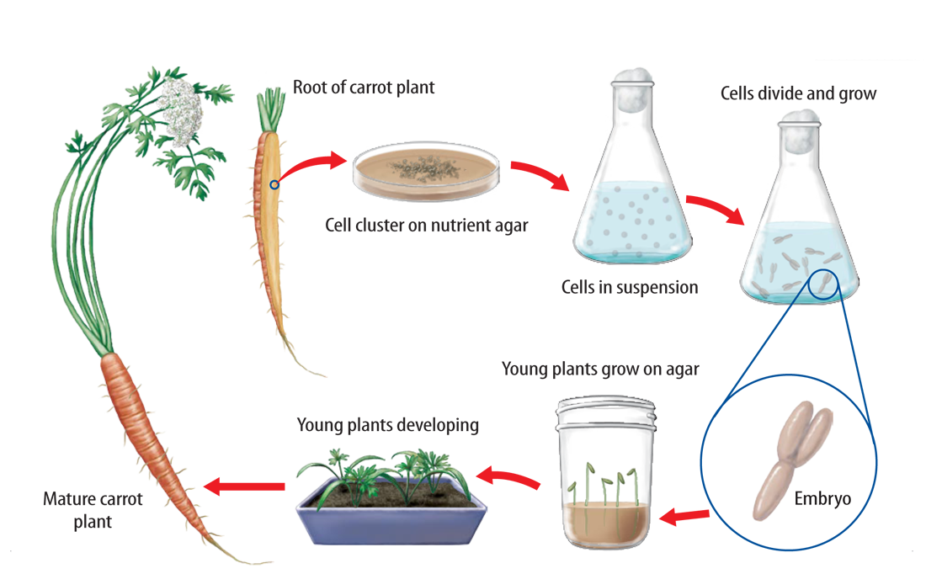
Lesson 2
Types of Asexual Reproduction (cont.)
Some plants can be cloned using a method called tissue culture.

Slide 50
Lesson 2
Types of Asexual Reproduction (cont.)
culture
Science Use the process of growing living tissue in a laboratory
Common Use the social customs of a group of people

Slide 51
Lesson 2
Types of Asexual Reproduction (cont.)
Compare and contrast the different types of asexual reproduction.

Slide 52
Lesson 2
Types of Asexual Reproduction (cont.)
One disadvantage of asexual reproduction is that the results offer little genetic variation within the population.
Asexual reproduction can also be responsible for harmful genetic mutations.

Slide 53
Lesson 2
Types of Asexual Reproduction (cont.)
One advantage of asexual reproduction is that it allows organisms to reproduce without a mate, saving time and energy.
Asexual reproduction also enables some organisms to produce large numbers of offspring in a short period of time.

Slide 54
Lesson 2
Types of Asexual Reproduction (cont.)
How is asexual reproduction beneficial?

Slide 55
Lesson 2
Types of Asexual Reproduction (cont.)
Crabgrass can spread quickly because it reproduces asexually.

Slide 56
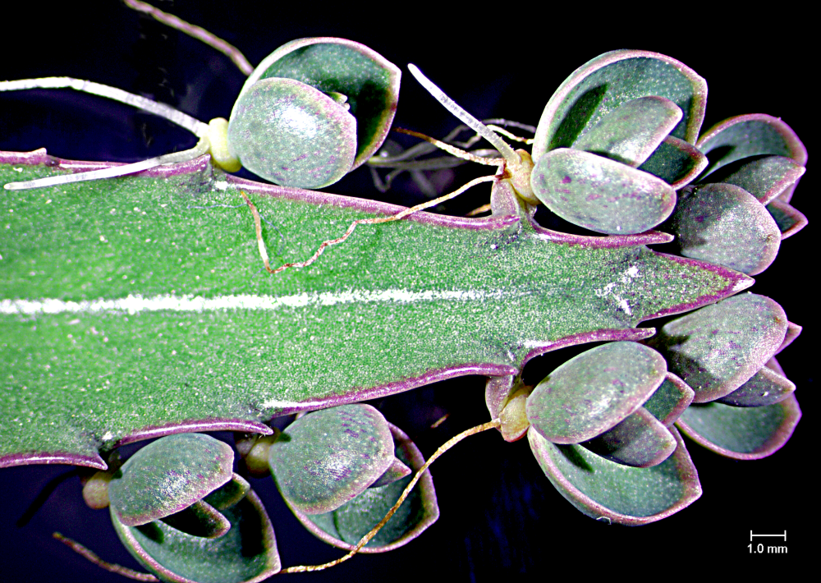
Lesson 2
In asexual reproduction, offspring are produced without meiosis and fertilization.
Steven P. Lynch

Slide 57
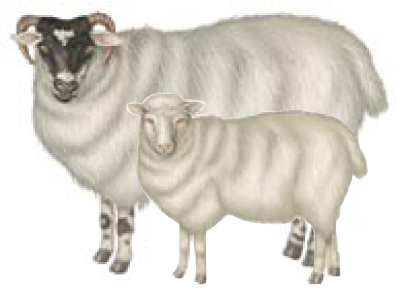
Lesson 2
Cloning is one type of asexual reproduction.

Slide 58
Lesson 2
Asexual reproduction enables organisms to reproduce quickly.

Slide 59
Lesson 2
Fission refers to the cell division of which of these?
A. DNA
B. eukaryotes
C. bacteria
D. prokaryotes

Slide 60
Lesson 2
In mitotic cell division, an organism forms two offspring through cell division and which other process?
A. mitosis C. fission
B. regeneration D. budding

Slide 61
Lesson 2
Which is a method for cloning some plants?
A. tissue culture
B. tissue budding
C. vegetative reproduction
D. fission

Slide 62
Lesson 2
Do you agree or disagree?
4. Cloning produces identical individuals from one cell.
5. All organisms have two parents.
6. Asexual reproduction occurs only in microorganisms.

Slide 63
Chapter Review Menu
Key Concept Summary
Interactive Concept Map
Chapter Review
Standardized Test Practice

Slide 64
The BIG Idea
Reproduction is essential for the survival of species.

Slide 65
Key Concepts 1
Lesson 1: Sexual Reproduction and Meiosis
Sexual reproduction is the production of an offspring from the joining of a sperm and an egg.
Division of the nucleus and cytokinesis happens twice in meiosis. Meiosis I separates homologous chromosomes. Meiosis II separates sister chromatids.
Meiosis maintains the chromosome number of a species from one generation to the next.
E. Pollard/PhotoLink/Getty Images

Slide 66
Key Concepts 2
Lesson 2: Asexual Reproduction
Asexual reproduction is the production of offspring by one parent, which results in offspring that are genetically identical to the parent.
Types of asexual reproduction include fission, mitotic cell division, budding, regeneration, vegetative reproduction, and cloning.
Asexual reproduction is advantageous because it enables some organisms to rapidly produce a large number of offspring in a short amount of time.
Steven P. Lynch

