Slide 1
Chapter Menu
Chapter 7 -
Bacteria and viruses

Slide 2
Lesson 1 Reading Guide - Vocab
What are Bacteria?
bacterium
flagellum
fission
conjugation
endospore

Slide 3
Lesson 1
Characteristics of Bacteria
Bacteria are microscopic prokaryotes that live in almost every habitat on Earth and in or on almost every organism, both living and dead.
Other prokaryotes, called archaea, are similar to bacteria and share many characteristics with them, including the lack of membrane-bound organelles.

Slide 4
Lesson 1
Characteristics of Bacteria (cont.)
Some bacteria have specialized structures that help them survive.

Slide 5
Lesson 1
Characteristics of Bacteria (cont.)
Bacteria are much smaller than plant or animal cells.
They have one of three basic shapes:
round or sphere-shaped
rod-shaped
spiral-shaped.

Slide 6
Lesson 1
Characteristics of Bacteria (cont.)
Bacteria live in many different places and obtain food in various ways.
Some bacteria make their own food by using light energy, like plants.
Others take in their nutrients from living hosts.
Other bacteria use energy from chemical reactions to make their food.

Slide 7
Lesson 1
Characteristics of Bacteria (cont.)
Some bacteria break down food to obtain energy.
These bacteria often live on dead organic matter.

Slide 8
Lesson 1
Characteristics of Bacteria (cont.)
Bacteria that can live where there is no oxygen are called anaerobic.
Bacteria that need oxygen are called aerobic.

Slide 9
Lesson 1
Characteristics of Bacteria (cont.)
Some bacteria are able to find their resources by moving around with special whiplike structures called flagella.

Slide 10
Lesson 1
Characteristics of Bacteria (cont.)
Some bacteria twist or spiral as they move, and others use their pili like grappling hooks or create threadlike structures that enable them to push away from a surface.

Slide 11
Lesson 1
Characteristics of Bacteria (cont.)
Bacteria reproduce asexually by fission—cell division that forms two genetically identical cells.
Genetic variation can be increased by a process called conjugation, in which two bacteria of the same species attach to each other and combine their genetic material.

Slide 12
Lesson 1
Endospores
An endospore forms when a bacterium builds a thick internal wall around its chromosome and part of the cytoplasm.
An endospore can protect a bacterium from intense heat, cold, or drought.

Slide 13
Lesson 2 Reading Guide - Vocab
Bacteria in Nature
decomposition
nitrogen fixation
bioremediation
pathogen
antibiotic
pasteurization

Slide 14
Lesson 2
Beneficial Bacteria
Most bacteria are beneficial and only a fraction cause diseases.
Many organisms, including humans, depend on bacteria to survive.
Some bacteria help with digestion and other body processes.

Slide 15
Lesson 2
Beneficial Bacteria (cont.)
Bacteria aid in the processes of decomposition and nitrogen fixation.
Decomposition is the breaking down of dead organisms and organic waste.
Nitrogen fixation is the conversion of nitrogen into a form that plants can use.
Organisms use nitrogen to make proteins.

Slide 16
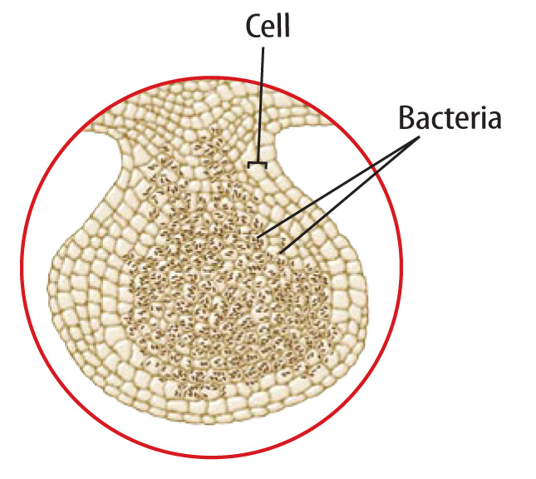
Lesson 2
The roots of some plants, including beans and peas, have nodules that contain nitrogen- fixing bacteria.

Slide 17
Lesson 2
Harmful Bacteria
Of the 5,000 known species of bacteria, relatively few are considered pathogens—agents that cause disease.

Slide 18
Lesson 2
Harmful Bacteria (cont.)
Some pathogens normally live in your body, but cause illness only when your immune system is weakened.
Other bacterial pathogens can enter your body through a cut, the air you breathe, or the food you eat.
Once inside your body, they can reproduce and cause disease.

Slide 19
Lesson 2
Harmful Bacteria (cont.)
Bacteria can harm your body and cause disease in one of two ways.
Some bacteria make you sick by damaging tissue.
Other bacteria cause illness by releasing toxins.

Slide 20
Lesson 2
Harmful Bacteria (cont.)
Antibiotics are chemicals that stop the growth and reproduction of bacteria.
Many types of bacteria have become resistant to antibiotics over time.

Slide 21
Lesson 2
Harmful Bacteria (cont.)
Random mutations occur to a bacterium’s DNA that enable it to survive or “resist” a specific antibiotic.
Over time, resistant bacteria will reproduce to become more common.

Slide 22
Lesson 3 Reading Guide - Vocab
What are Viruses?
virus
antibody
vaccine

Slide 23
Lesson 3
Characteristics of Viruses
A virus is a strand of DNA or RNA surrounded by a layer of protein that can infect and replicate in a host cell.
A virus does not have a cell wall, a nucleus, or any other organelles present in cells.
Viruses can have different shapes, such as crystal, cylinder, sphere, and bacteriophage shapes.

Slide 24
Lesson 3
Characteristics of Viruses (cont.)
A virus is not a living thing because it does not have all the characteristics of a living organism.
A virus can make copies of itself in a process called replication, but it must rely on a living organism to do so.

Slide 25
Lesson 3
Characteristics of Viruses (cont.)
Viruses must use organisms to carry on the processes that we usually associate with a living cell.
Viruses have no organelles so they are not able to take in nutrients or use energy.
Viruses must be inside a cell, called a host cell, to replicate.

Slide 26
Lesson 3
Characteristics of Viruses (cont.)
When a virus enters a cell, it can either be active or latent.
Latent viruses go through an inactive stage and their genetic material becomes part of the host cell’s genetic material.
Once it becomes active, a virus takes control of the host cell and replicates.

Slide 27
Lesson 3
Characteristics of Viruses (cont.)
A virus can only attach to a host cell with specific molecules on its cell wall or cell membrane.
After a virus attaches to a host cell, its DNA or RNA enters the host cell.
Once inside, the virus either starts to replicate or becomes latent.

Slide 28
Lesson 3
Characteristics of Viruses (cont.)
After a virus becomes active and replicates in a host cell, it destroys the host cell.
Copies of the virus are then released into the host organism, where they can infect other cells.
As viruses replicate, their DNA or RNA frequently mutates, enabling them to adjust to changes in their host cell.

Slide 29
Lesson 3
Viral Diseases
Most viruses attack and destroy specific cells, which causes the symptoms of disease.
Some viruses, like influenza, begin to replicate immediately and cause symptoms soon after infection.

Slide 30
Lesson 3
Viral Diseases (cont.)
Other viruses, like HIV (human immunodeficiency virus), might not cause symptoms right away because the infected cells might continue to function normally for a period of time after infection.
People infected with latent viruses might not know for many years that they have been infected.

Slide 31
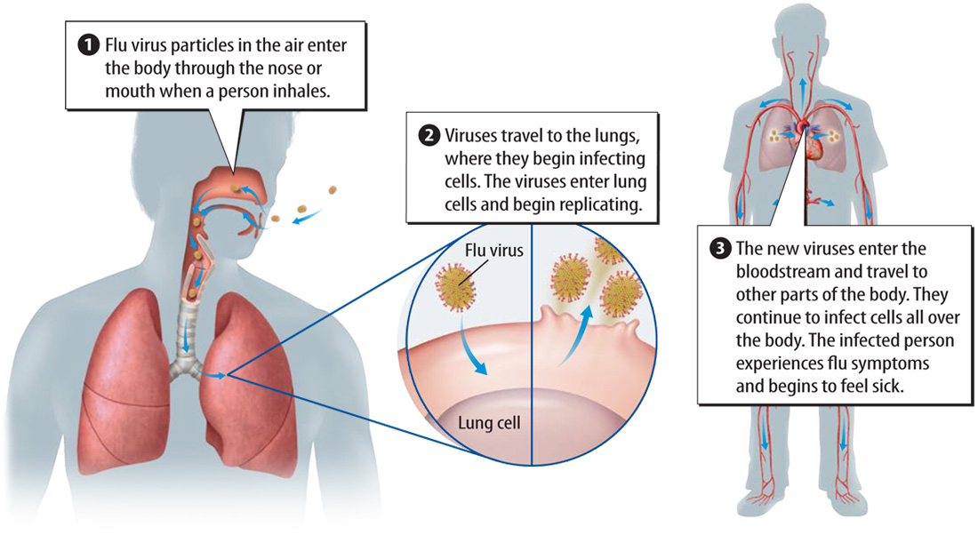
Lesson 3

Slide 32
Lesson 3
Treating and Preventing Viral Diseases (cont.)
An antibody is a protein that prevents an infection in your body.
When a virus infects a person, their body begins to make antibodies.
Antibodies bind to viruses and other pathogens and prevent them from attaching to a host cell.

Slide 33
Lesson 3
Treating and Preventing Viral Diseases (cont.)
A vaccine is a mixture containing material from one or more deactivated pathogens, such as viruses.
After being vaccinated against a particular pathogen, the organism will not get as sick if exposed to the same pathogen again.

